Slide 1
The Story of Change “Using TMSC”

Slide 2
Hello!
I am Dana Abu-Goura
Director- Islamic Cultural Society
Amman – Jordan

Slide 3
Let’s start with this Video

Slide 4
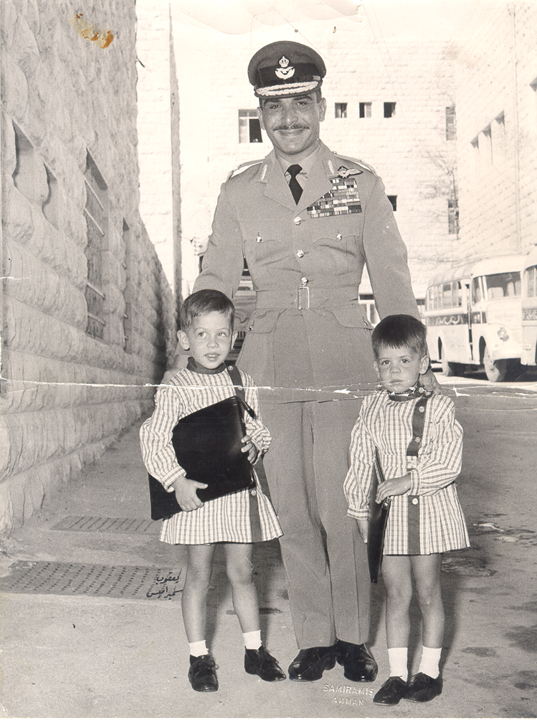
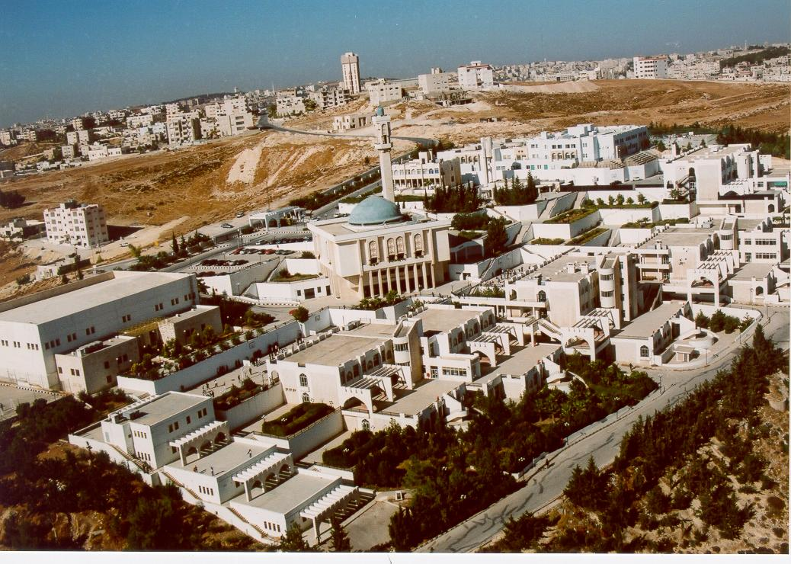
Who We Are ?
The Islamic Cultural Society (ICS) was established in 1944 in Amman, Jordan. ICS is a non-for-profit society, one of its essential objectives was to establish a private non-profitable institute that provides a bilingual learning in a moderate atmosphere, and whose educational and adminstrative policies aer set by the ICS’s board of trustees.
Fortunately, in 1947 the School of Islamic Educational College was etablished under the umbrella of the Islamic Cultural Society with only 155 students… And now the school expanded to have two venues with almost 5,500 students.
It was an honor for the schools to have some of the Royal Family members among its students, in addition to many distinguished figures.

Slide 5
Technology will NOT replace teachers .....
...But Teachers who use technology will probably replace teachers who do NOT

Slide 6
Our Journey with the Smart Education Implementation
We implemented TEAM Model Smarter Classrooms (TMSC) at the entire American & British Programs in record time.
This has been a welcome change, as in the past the IT department had many hurdles.
The deployment of TMSC has been easy for teachers’ teaching and students’ learning.
The friendly using of the IRS and document camera by TMSC total solution combined with a lot of planning helped us to enjoy a smooth and painless deployment.

Slide 7
“If we teach today as we taught yesterday, we rob our children of Tomorrow” (John Dewey)

Slide 8
Technology Challenge Facing Education
Despite increasingly widspread adoption of technologies in virtually every aspect of k-12 education, significant challenges are preventing widspread effective implementation.
According to researchers, though some of those challenges are systemic and some related to technologies themselves, teachers and education leaders share in the blame as well.
Some of these challenges are: 1-The lack of professional development for teachers who are required to integrate new technologies into their calssrooms.
2- Resistance to change or what we can call it “comfort with the status quo”, as some teachers and school leaders often see technological experimentation as outside the scope of their job.

Slide 9
Challenges we Faced
Some teachers’ resistance to change
Allocate proper resources to facilitate the implementation
Effective Use of Techology

Slide 10
Our process was easy
We involved schools in planning
In corporation with the vendor:
Training, Follow-up, Teachers’ competitions
Help Desk

Slide 11
The successful delivery of TMSC
Tablet | Documents Camera | HiTeach Software | IRS | Touch Screens | year
0 | 4 | 4 | 4 | 4 | 2014-2015
60 | 28 | 28 | 28 | 28 | 2015-2016
700 | 36 | 36 | 36 | 36 | 2016-2017

Slide 12
Smarter school during the four previous years

Slide 14
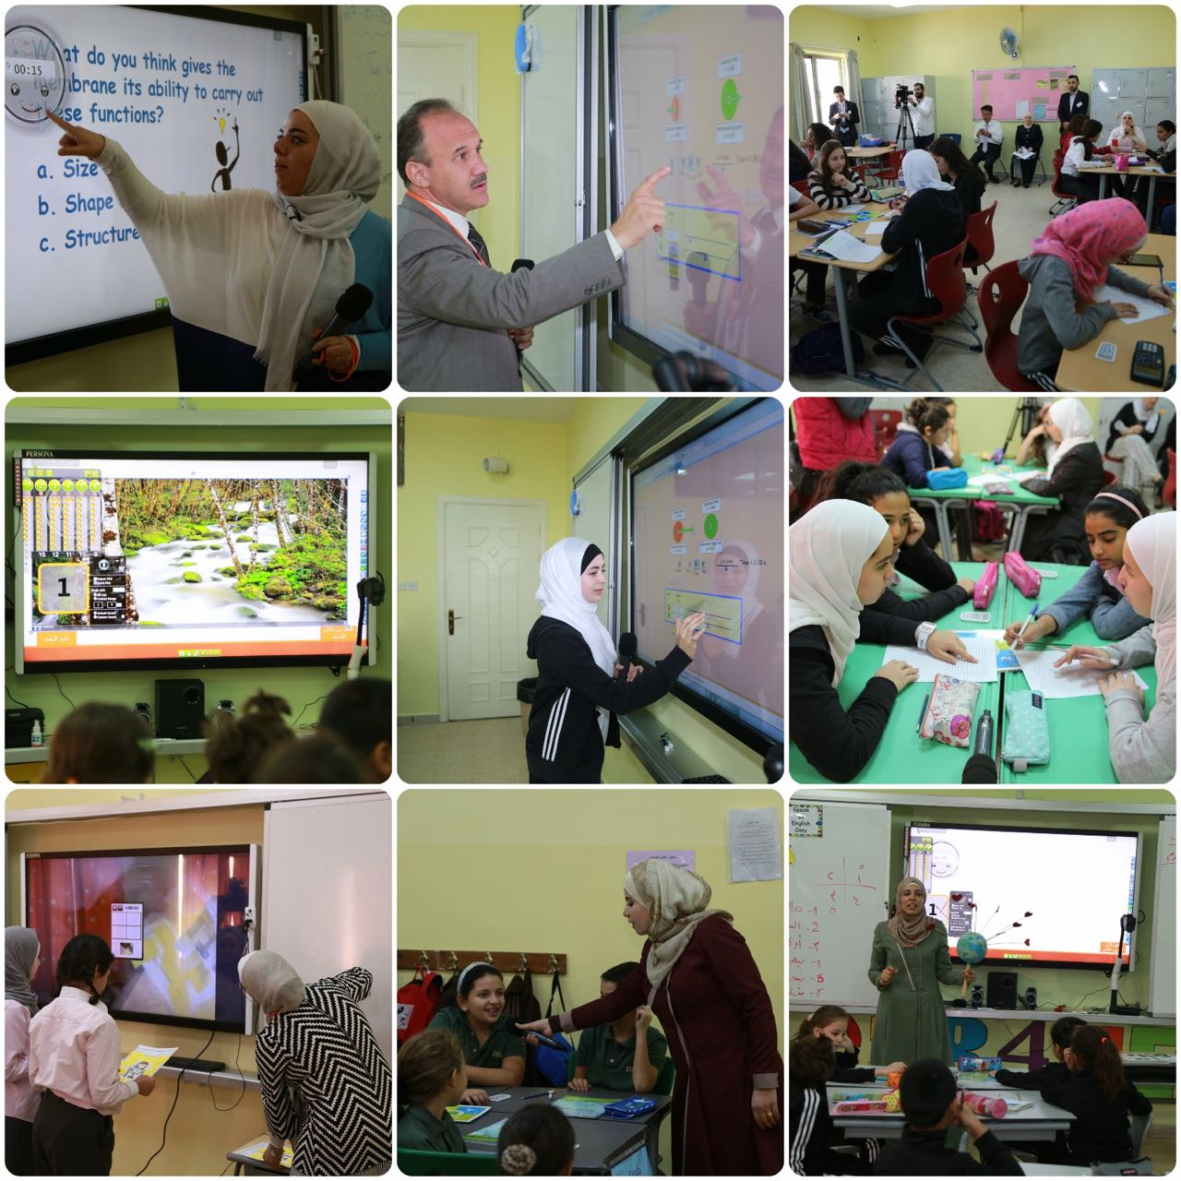
Deliverables
1- Joyful & proactive learning environmnet .
2- Enabled the teachers to achieve not only team-based learning thoroughly but also innovatively.
3- Students started to enjoy their school time.

Slide 15
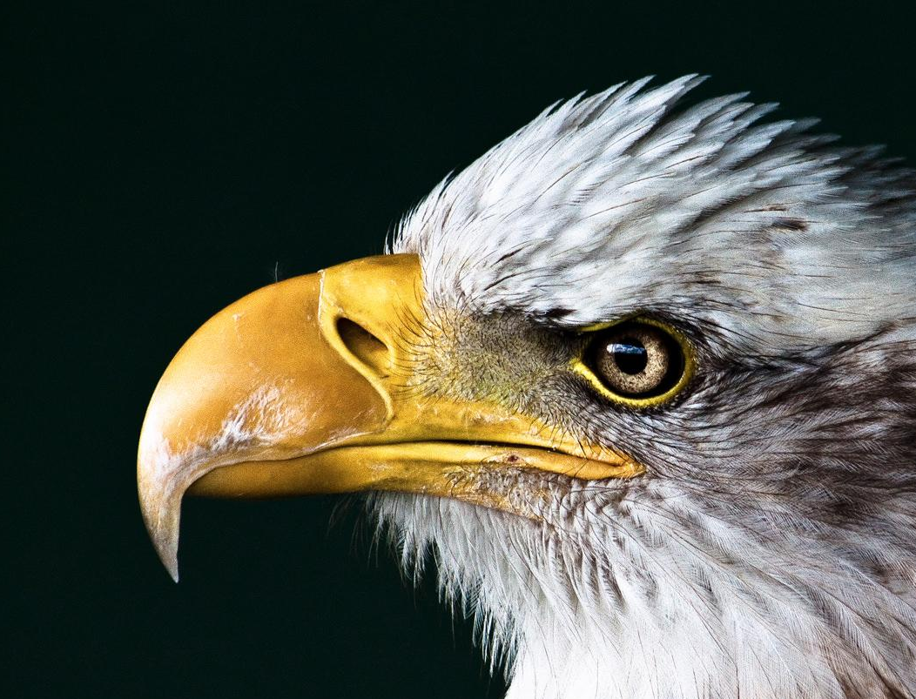
A Video is worth a thousand words

Slide 16
Thanks!

