Slide 1
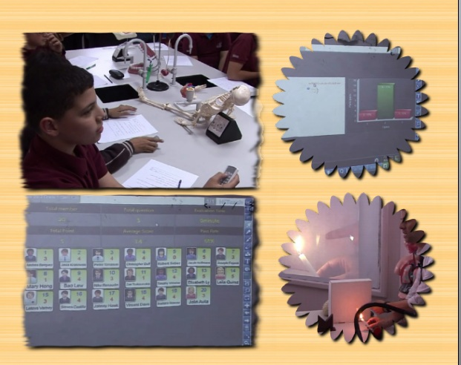
MODREN SYSTEMS SCHOOLS

Slide 2
Ghadeer A. Alkatib Supervisor of math & E-learning Department in Modern SystemS Schools
1) Participating as a subject matter expert (SME)in developing e-math program with Cisco Learning Institute and Rubicon
2) A 3 - year experienced in the field of Managing Development Projects with a focus on e-learning development projects in Jordan. Monitoring implementation and evaluation of impact in Directorate of Curriculum at the Ministry of Education.
3) Having Certificate of Excellence from Cisco Learning Excellence to lead training of e-math and preparing professional development in Jordan and the Middle East
4) Academy researcher in revising and studying interactive educational sites and mapping between them and the curriculum

Slide 3
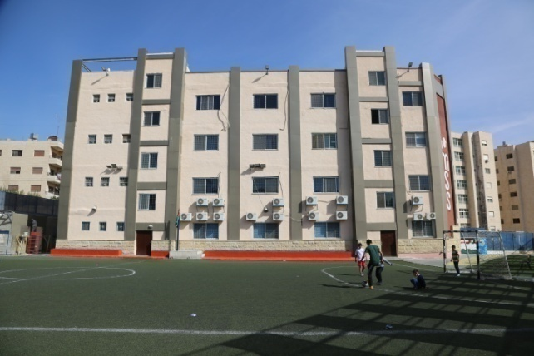
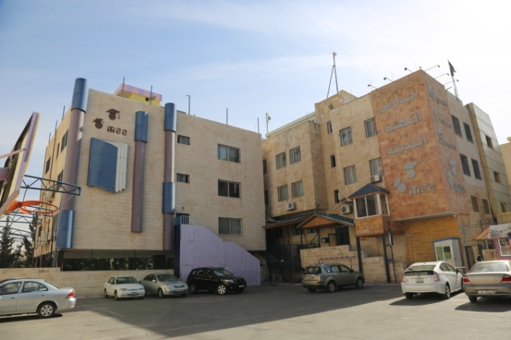
Modern Systems Schools (MSS)
Modern Systems Schools was founded in 2005-2006. It has three main separate schools for boys and girls and a separate kindergarten. Boys' school has two branches, one for secondary stage and the other is for primary and intermediate stages. Girls' school has three stages, primary, intermediate and secondary.

Slide 4
International Policy of our Schools
Realizing that man is the means, tools and ultimate goal of
human development, our schools have been constantly
working on providing students with the essential skills
(communication skills, critical & creative thinking, and
problem solving) tools to step forward into a competitive
world as active global citizens aware of their national and
international identity

Slide 5
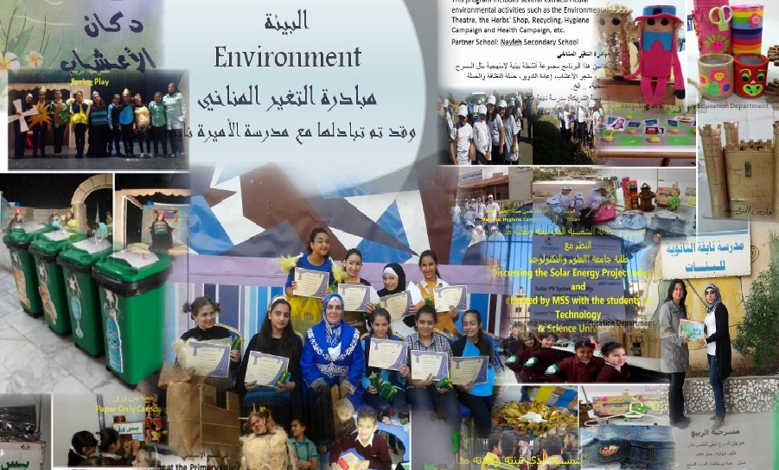
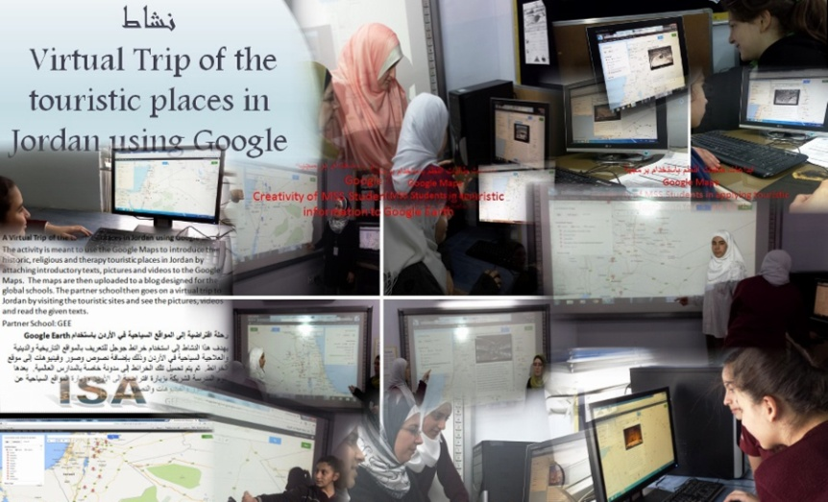
Our Schools’ Mission
1) acquire and master 21st century skills
2) use 21st century skills independently and interdependently
3) raise awareness and take action in protecting and improving the surrounding environment
4) respect differences in cultures & beliefs
5) involve staff in the development of teaching practices through collaborative projects with the partners

Slide 6
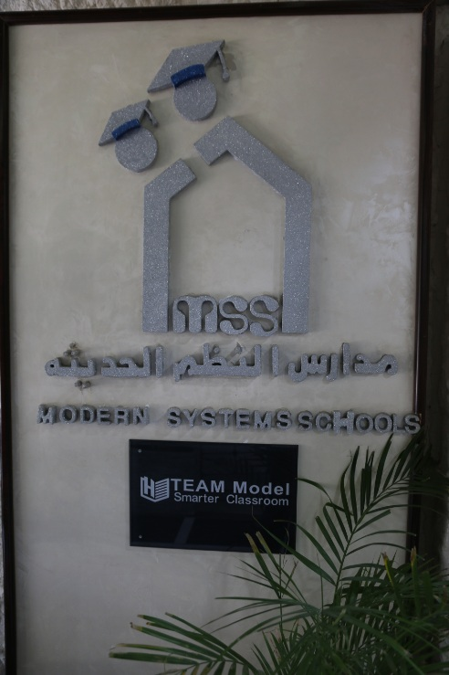
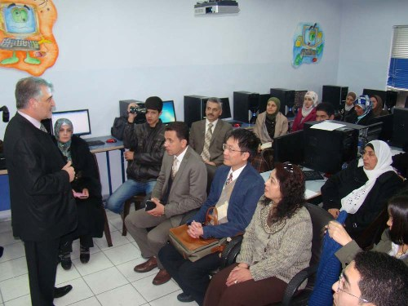
MSS has used a variety of technological tools, means and e-programs, such as the document camera(DC), voting system (IRS), e -currcuilum, Hi-Teach,TBL software, Tablet, and smart board, which created our own smart classroom.

Slide 7
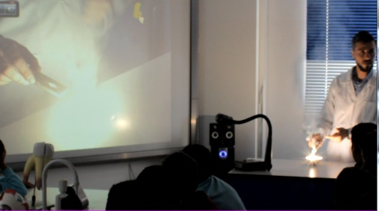
New Teaching Model In Science Lab
“Why not use the IRS system in the science lab?”
We started by training one of the teachers to use Hi-Teach software with IRS tools.
The teaching strategy : To hold the
experiment, assign a set of questions to be
answered by students whose
progress would be
evaluated by the teacher
to determine how many
goals have been achieved.

Slide 8
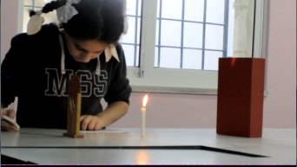
Applying the IRS after the experiment
had been a success, I decided
to train other teachers of 4th
to 7th grades to use Hi-Teach
software with IRS after they finish any held
experiment in the science lab.
Nothing can be changed smoothly
Resistance was noticed among teachers who
refused to change their usual teaching strategies in
the science lab.

Slide 9
An Example Story
One of the excellent teachers, a resistant of this
strategy implementing, has always complained that
some of her 5th graders were very noisy and that
they needed extra effort to get their attention back
to the experiment, which was really tiring. She also
added that she had had tried praise, giving extra
assignments, and even warnings but nothing helped.
However, when she used this new lab teaching
strategy, all students were attracted and active
which, as a result, made her content and a supporter
of using Hi-teach with IRS. In fact she was
encouraged to tell other science teachers of upper
grades about her new experience.

Slide 10
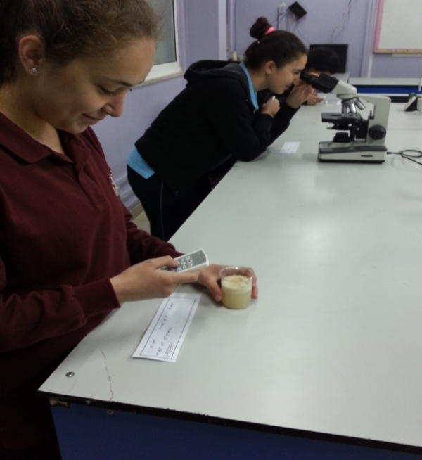
Accordingly, those teachers of upper grades and
who use the science lab more often and who also
heard about the teacher’s experience showed
interest. So, I recommended using the same
strategy after each experiment , not only during
the usual classes but
also during the final practical
science exams , similarly as done in
colleges with one difference which
is the use of the IRS in our schools.

Slide 11
A Practical Science Lab Exam with IRS
The previous videos were an example in which the document camera and IRS were used to perform a practical science lab exam.
The steps can be summarized as follows:
The teacher introduces a practical experiment using the document camera.
The teacher prepares the exam using self base mode in Hi-teach software.
To asses the student’s performance, the teacher prepares different questions and places them next to the experiment tools.
Students answer a question using the IRS and then move around to another place to answer the next question.

Slide 12
Model Structure (Flow Chart)
TMSC Learning and Self-Pace Examination through Science Experiments
Lecturing
Experimenting
Critical Thinking
Reporting
Reading
Evaluating
Approaching in Answering

Slide 13
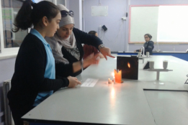
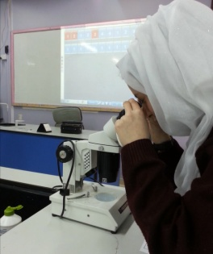
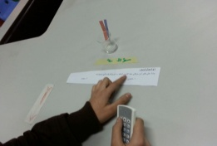
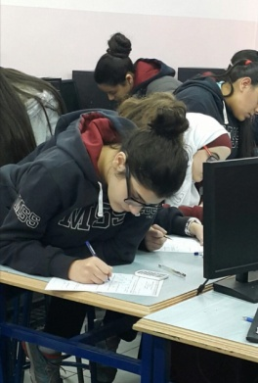
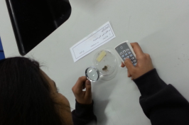
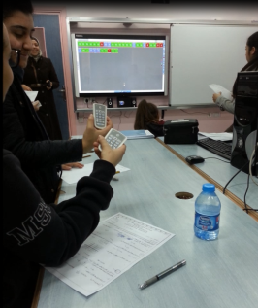
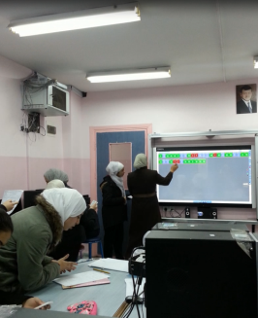
Model Description with Photos
Step 1 | Lecturing | Lecture on general concepts through TBL, including IRS activities.
Step 2 | Experimenting | Demo the experiments via Document Camera.
Step 3 | Reading | Each student read the question associate with the experiment on the station in front of them.
Step 4 | Critical Thinking | Student will recall what the teacher taught earlier and think critically in order to respond the question.
Step 5 | Approaching in Answering | Student may conduct the experiment in front of them before choosing an answer.
Step 6 | Evaluating | Instant evaluation during the answering from each student.
Step 7 | Reporting | Teacher gets report immediately after evaluation.

Slide 14
IRS Self-Paced Testing Horizontal 1~40 indicates student 1 to 40; Vertical 1-10 indicates experiment 1-10

Slide 15
Effectiveness Analysis

Slide 16
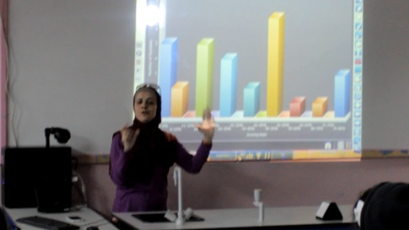
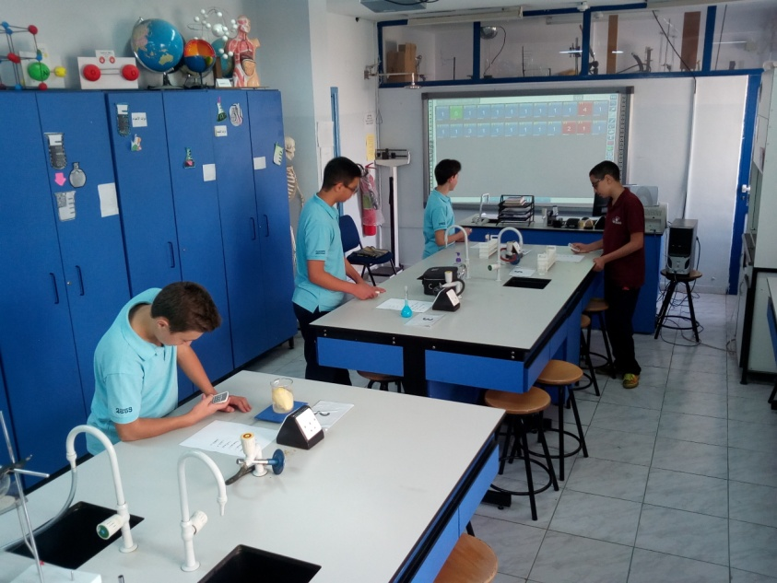
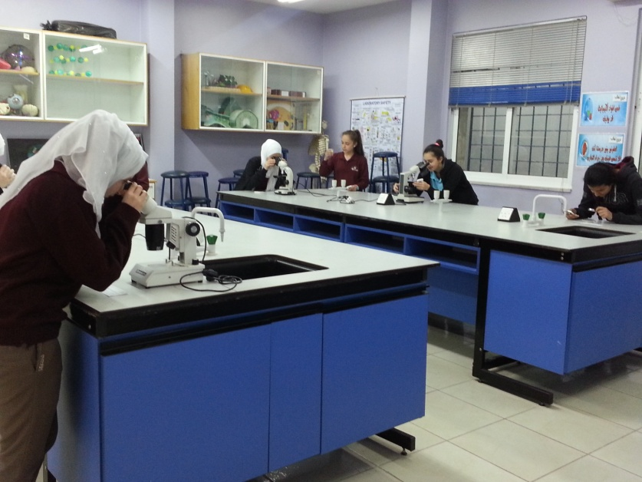
Speedy access to the results of the students
As the last student is done, and in one click, the teacher gets all the students’ results. (the students can see their results immediately after the completion of the practical test).

Slide 17
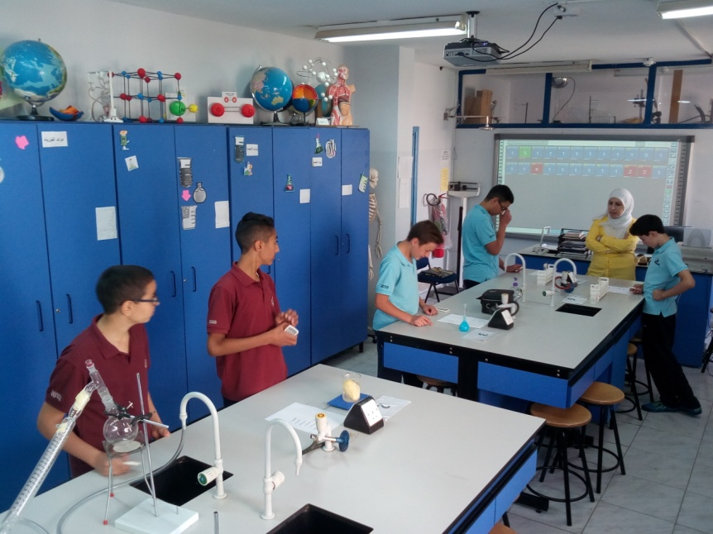
Advantages of Using IRS in a Practical Science Exam
The gained advantages of using IRS can be classified in three categories.
1. For Teachers
Raising motivation .
Saving time and effort.
Monitoring the students’
progress through the
statistic analysis.
Determining the students’ weakness and strength points.

Slide 18
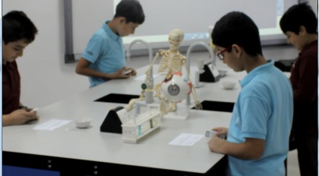
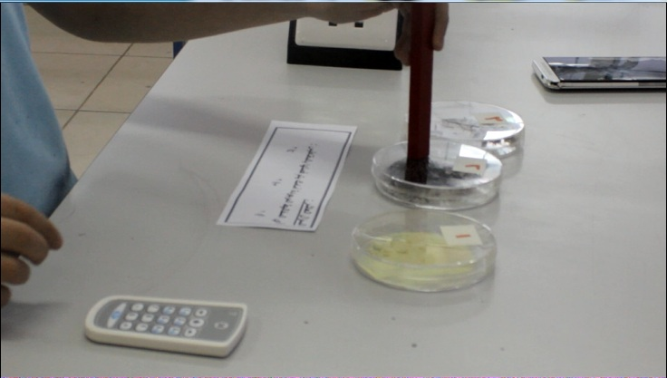
2. For Students
Showing willingness and commitment to the experiments in general
Showing improvement in performance as a result of being monitored on the screen.
Raising motivation and encouragement to have a practical exam without fear
Raising the spirit of challenge among the class.

Slide 19
3. for E-Learning Department
We are now picking the fruit of our work.
Teachers have become demanders of Hi-Teach software with IRS to be available in each science lab.
Resistance of this specific tool has disappeared from our schools and inspiration has spread.
We achieved the professional development that we were looking forward to.

Slide 20
OUR FUTURE PLANS IN THE USE OF TECHNOLOGY
MSS has almost ended designing the LMS, which allows our schools to connect the managing departments, teachers, parents and students. LMS is going to allow students to receive assignments, e-exams, missed classes, etc. It is also going to allow parents receive reports about their children’s academic accomplishments and behavioral attitude.
On top of that, it is going to allow the head of schools monitor the whole institutional work.

Slide 21
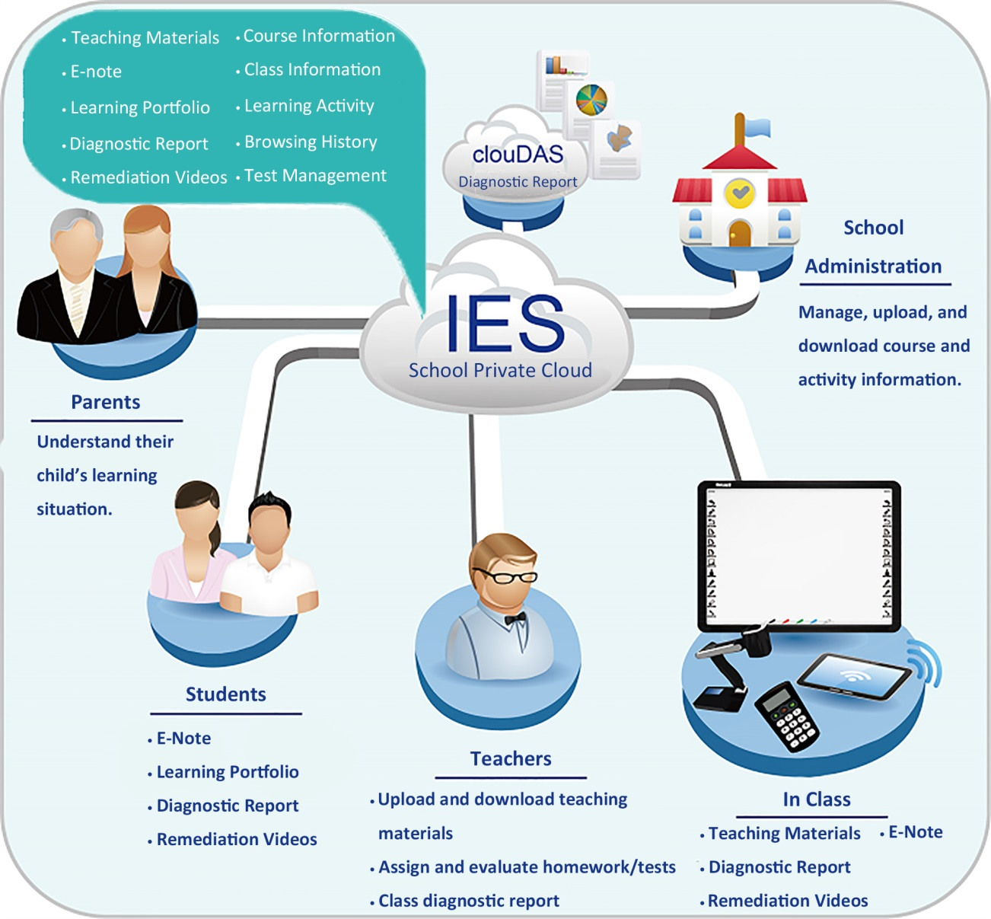
MSS Final Major Goal
Connect to the cloud computing in order to allow users
access all applications and services, upload the available
information, and reduce costs for users.

Slide 22
THANK YOU !

