Slide 1
Professional Development of Teachers Dayou Junior High School
Presented by Chen, Chia-Hsiang

Slide 2
Outline
1. Principles of Implementation
2. Professional Development System for Teachers: Climbing Plan
3. 4 to “Give”
4. Eight Steps for Change Management

Slide 3
1. Principles of Implementation
(1) Principle of Philosophy Clarification: research/learning, practicing, sharing, feedback.
(2) Principle of “Easy to Difficult”: change the mindset, and make the first step.
(3) Principle of Learning Community: teamwork and common preparation for teaching-viewing and reviewing.
(4) Principle of Discussion and Sharing: participation to teaching research conferences and seminars.
(5) Principle of Encouragement to Achievement:teaching demonstration, recognition of excellent performance, verbal praise, participating class competition.

Slide 4
2. Professional Development System for Teachers:(Climbing Plan)
(1) Time:
1. Field Education Study: 2 hours (1 hour for explaining, 1 hour for review and verification)
2. Advancing Self-learning of teachers
(2) Partner: members of the core group at the 1st stage of the 7th grade

Slide 5
2. Professional Development System for Teachers:(Climbing Plan)
(3) Five Stages:
1. Hutou Mountain: computers, projectors, Hi-Teach starting, choosing classes,
and choosing model.
2. Yangmingshan: zoom-in and zoom-out, choosing teaching materials, exchange of teaching materials and TBL, adding
new pages, previous and next page.

Slide 6
2. Professional Development System for Teachers:(Climbing Plan)
(3) Five Stages
3. Hehuan Mountain: choosing a pen, choosing an eraser, timing, picking student, partial zoom-in.
4. Snow Mountain: IRS Q&A, flipping cards, statistics, fighting for the right, re-fighting
5. Yushan:score table, HiTA, tablets, calibration of touch panel.

Slide 7
2. Professional Development System for Teachers:(Climbing Plan)
(4) Awards:
1. A lottery ticket is awarded for conquering each mountain.
2. Five tickets will be thrown to five lucky-draw boxes, to increase the chance of winning.
3. Twelve winners are drawn every month to be awarded for 100 NTD prize.
4. If all the members of a field group pass the Snow Mountain stage, all of them will receive teatime coupons in hotels.
5. Passing the Yushan Stage, an iPhone 7 and two Apple iPads are awarded at the end of semester

Slide 8
3. 4 to "Give"
(1) Give Resources
(2) Give Stage Performance
(3) Give Encouragement
(4) Give Consolation
.

Slide 9
4. Eight Steps for Change Management (Change management 8 steps)
(1) Establisha sense of crisis
(2) Buildleader teamwork
(3) Makea vision
(4)Communicate the vision of change
(5)Removechangeobstruction

Slide 10
4. Eight Steps for Change Management (Change management 8steps)
(6)Makinga short success
(7)Norelaxationonlyfor the preliminarysuccess
(8)Buildculture of change

Slide 11
There is no point of return
Just take away the cover of convention

Slide 12
We need to teach smartly,
And kids need to learn smartly.
Efficiency is the key!

Slide 13
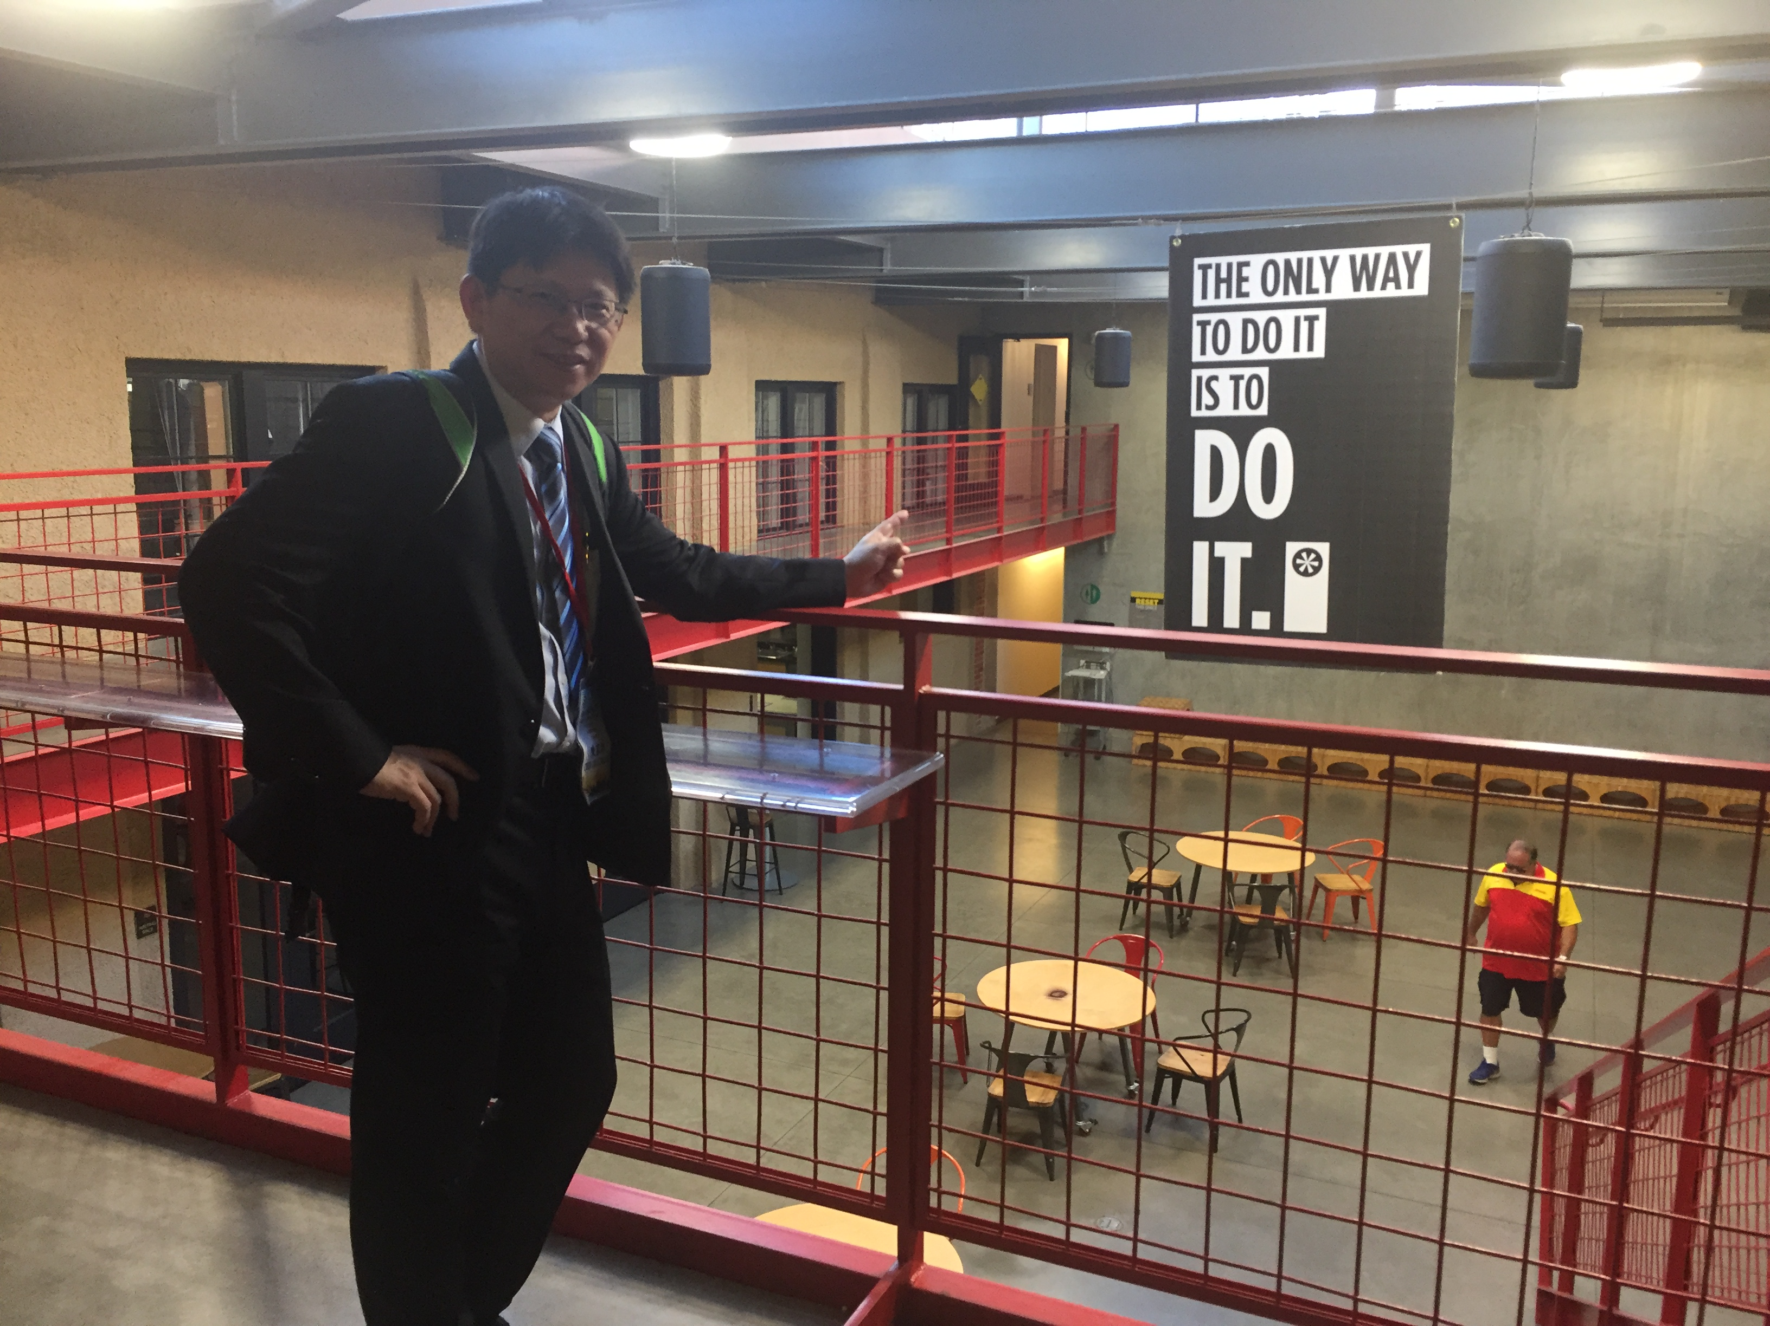

Slide 14
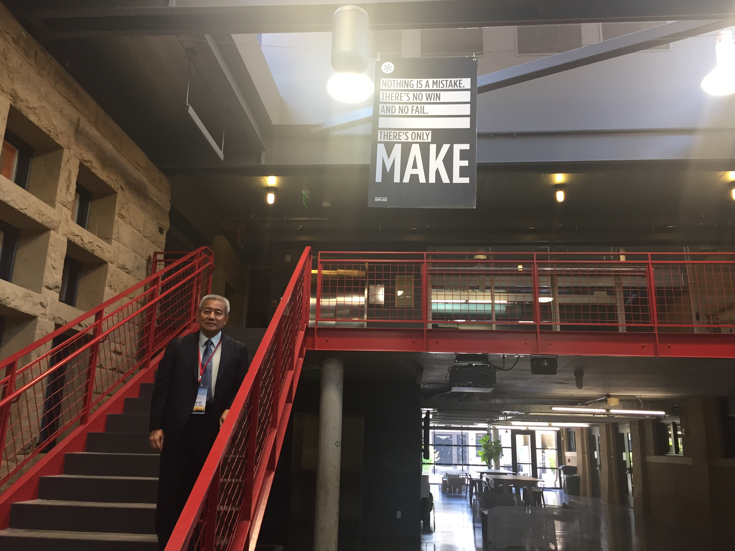

Slide 15
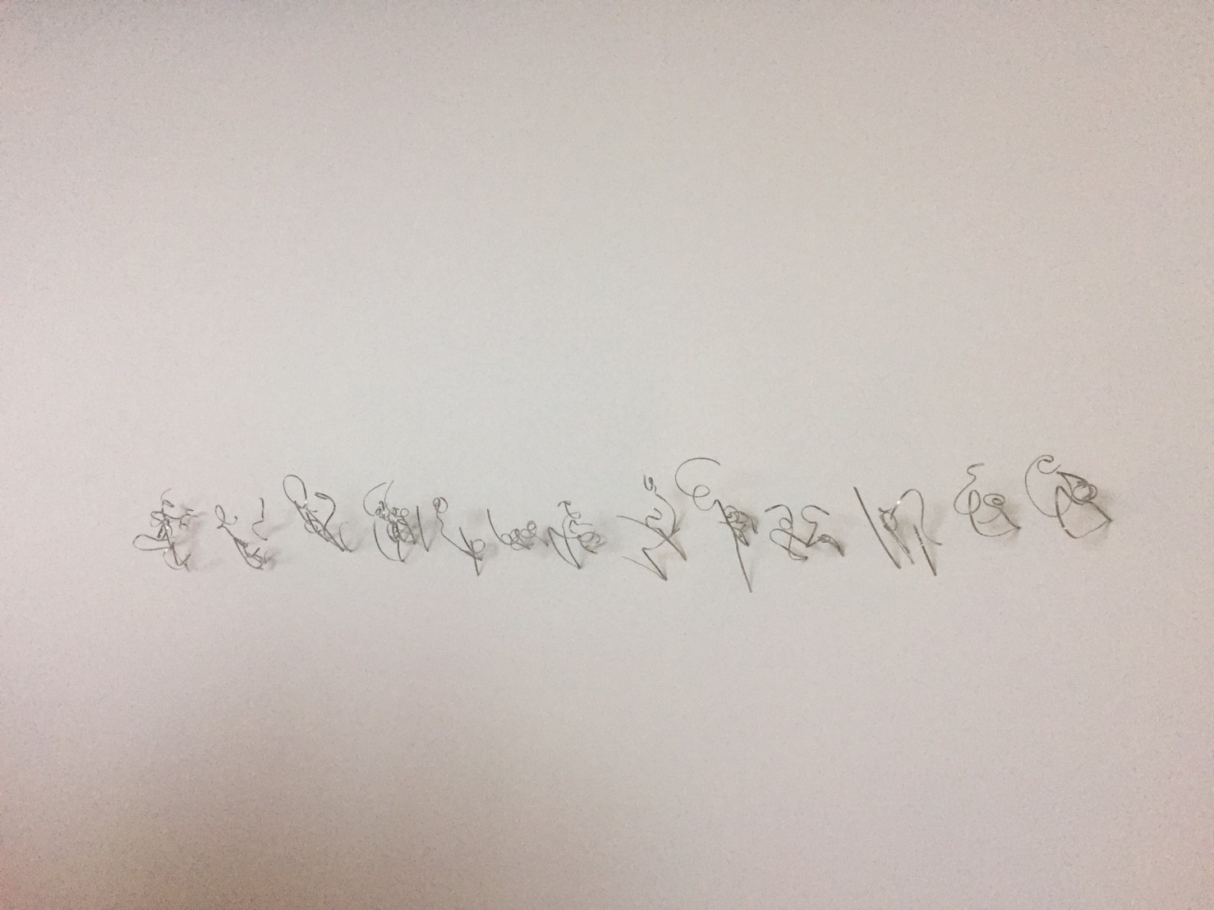

Slide 16
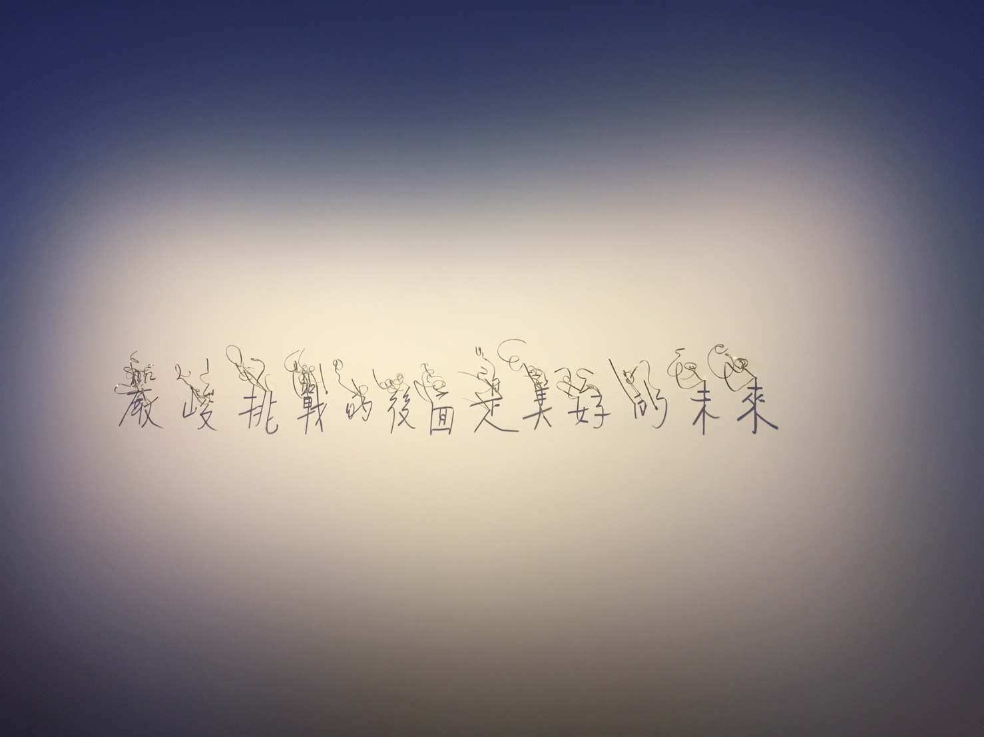

Slide 17
THANK YOU! A presentation from an insignificant one E-mail：dayouprincipal@gmail.com Mobile：0918-529-049

