Slide 1
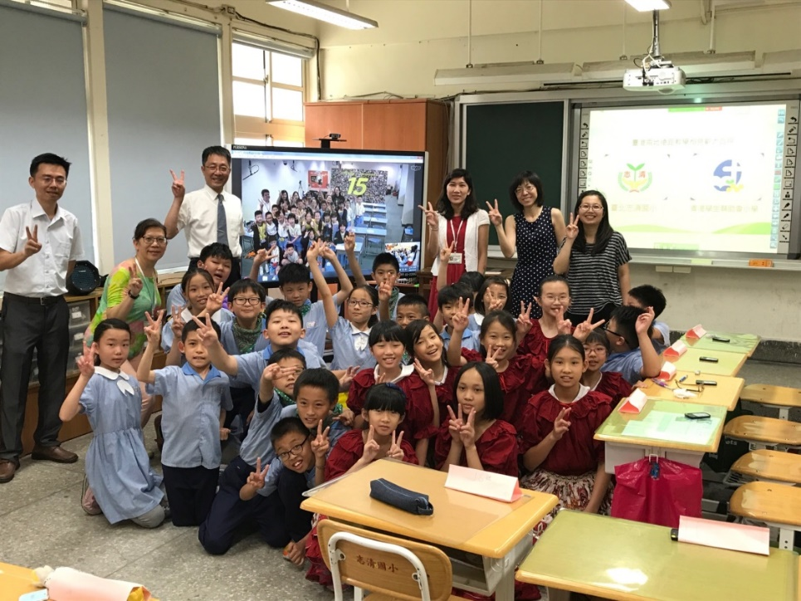
I-Common Advantages by Zhiqing
Remote Smart Class Coalition 5 Common Models
Ms. Li, Hsueh-Feng, Principal, Zhiqing Elementary School, Taipei City
Nov 9,2017

Slide 2
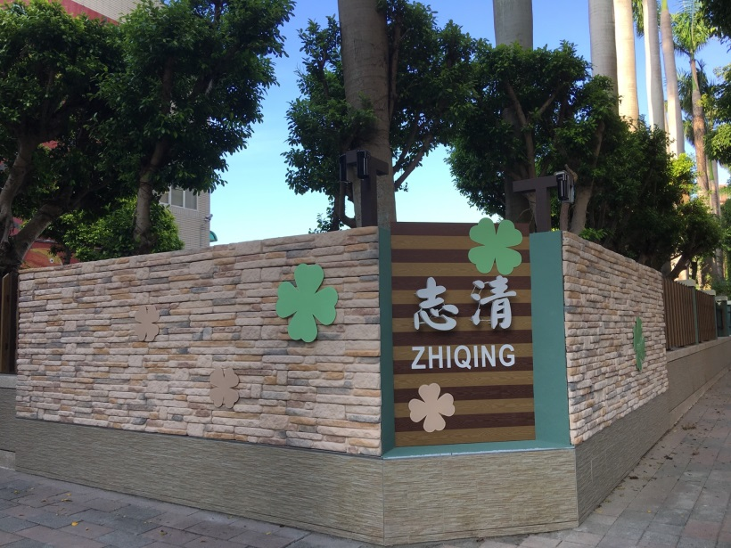
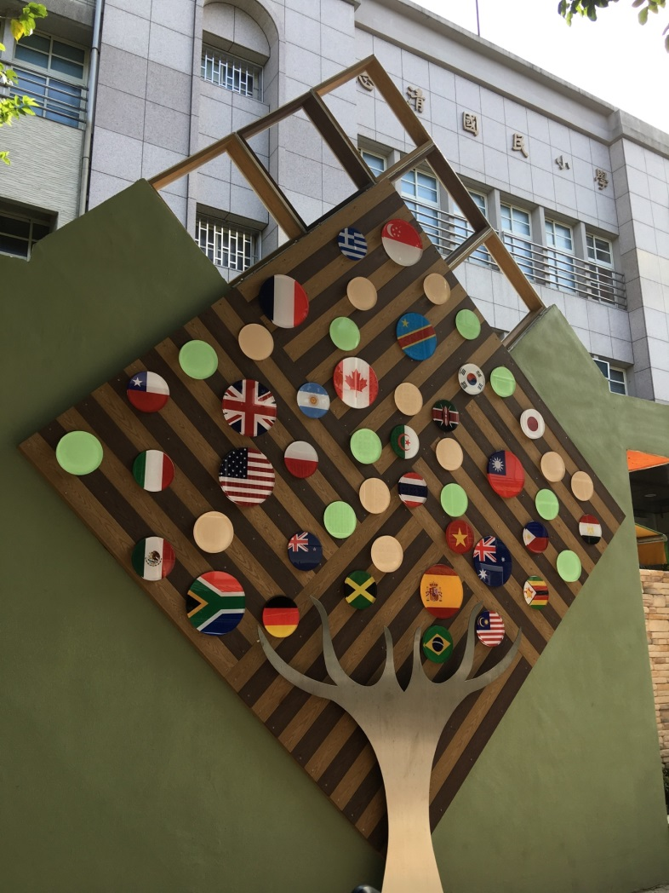
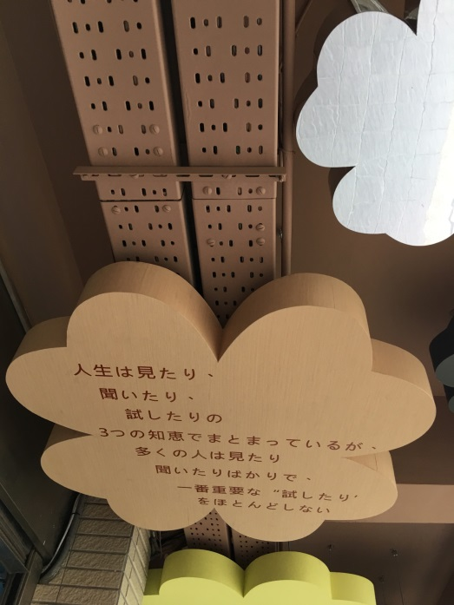
Feet on Zhiqing, Eye on the World

Slide 3

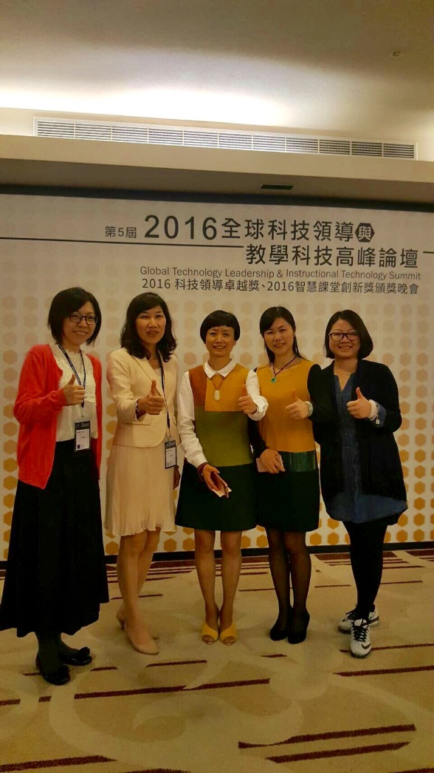
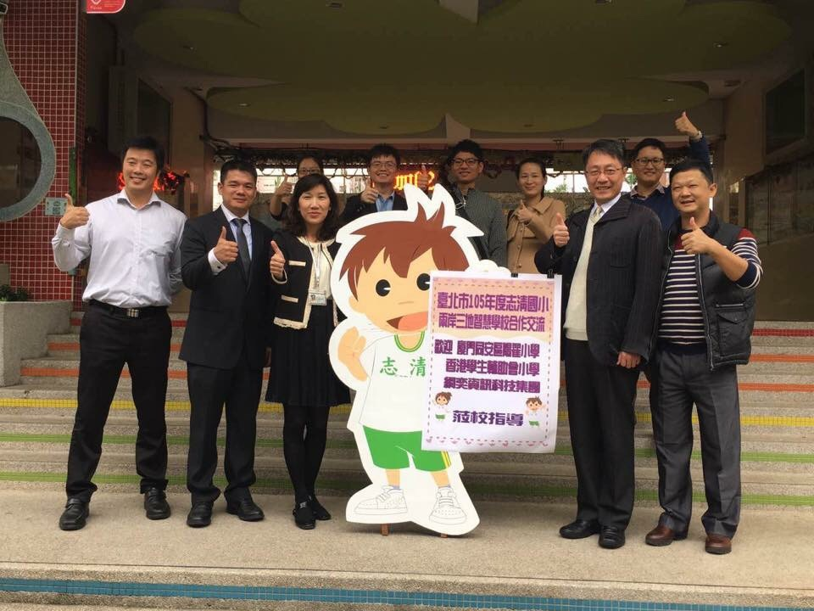
Remote Smart Class Coalition among 4 Locations Cross-Strait
The Start
Four Smart Schools

Slide 4
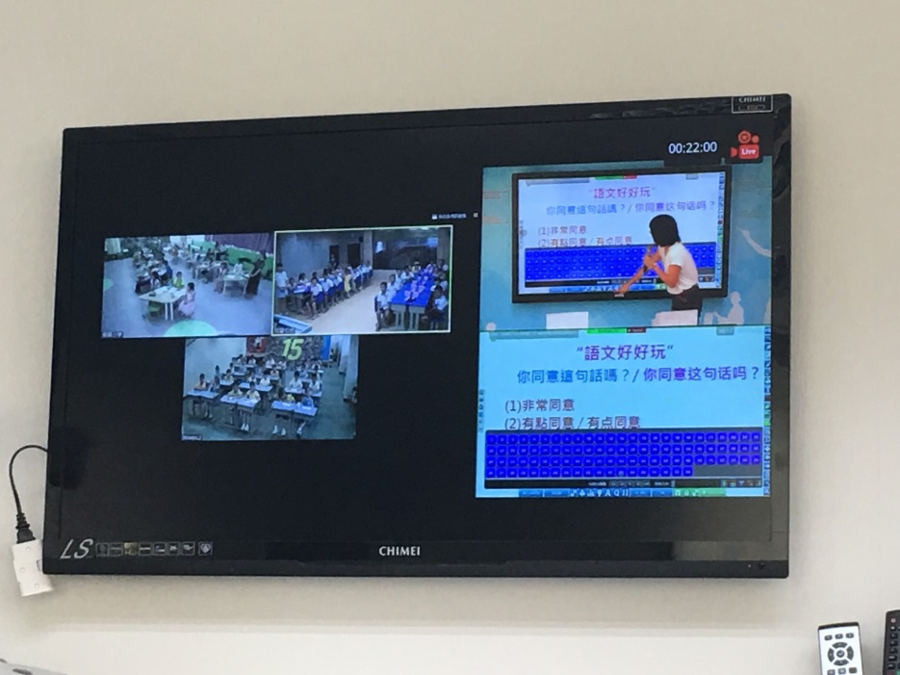
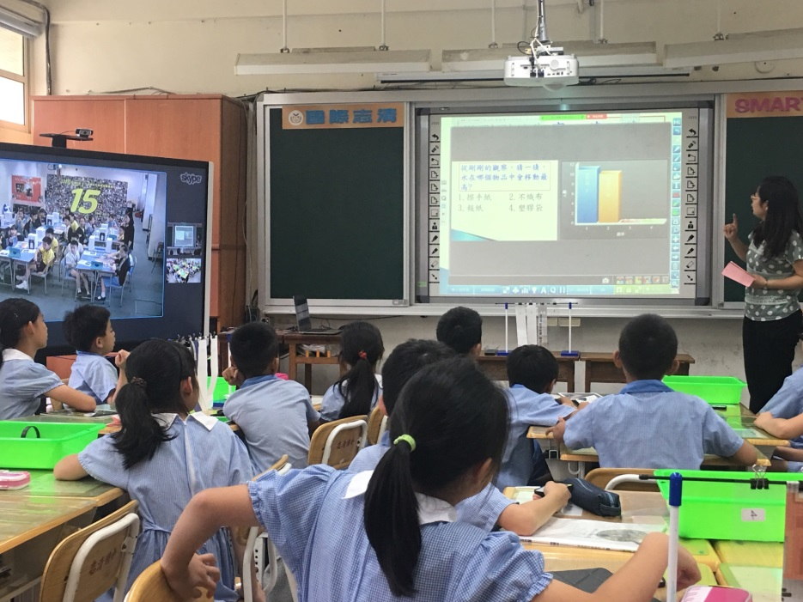
Education Technologies
Breakthrough the Barriers of Time and Space

Slide 5
The Remote Classrooms
in the Era of Big Data
Real-Time Feed Back
Statistical Analysis
Feedback Teaching

Slide 6
Expand the Views~Cross-School Interactions among Students
Interactions between Teachers and Students, and Interactions among Teachers
Common Learning
Common Learning with Technologies, Real-Time Interaction
Data Interactions
Real-Time Feed Back
Common Research
Common Research by Experts, Enhancement of Teaching-Review
Teaching & Research for Subject, Common Advantages for Three Schools
Common Advantages
Advantages to Students
Common Preparation
The Common Preparation among the Teacher Team and Professors
Planning Group
Technology Group
Teaching Group
Common Appreciation
Talent Shows to Experience Cultures
Interactions between Teachers and Students
Developing the Mutual Understanding
Advantages to Teachers
Advantages to Schools
Common Advantages to the Coalition Schools

Slide 7
The Excellent Smart Schools, Creates Common Advantages by Cooperation
Name of the Coalition | Participating Schools | Pattern of Common Learning | Subject Fields | Content
Remote Smart Class Coalition among 4 Locations Cross-Strait | Zhiqing Elementary School, Taipei City Hong Kong Student Aid Society Primary School Yangzhai Elementary School, Xiamen Yindo Zhiteng School, Chengdu Normal University | 1+1 0+3 | Chinese English Math Nature and Life Technologies | Common Appreciation Common Preparation Common Learning Common Research
The Excellent School Coalition of the Remote Smart Classroom in Greater China Area | Zhiqing Elementary School, Taipei City Hong Kong Student Aid Society Primary School Taijiang The Third Central Elementary School, Fuzhou | 1+2 | Chinese English Arts and Humanity | Common Appreciation Common Preparation Common Learning Common Research + Teaching & Research

Slide 8
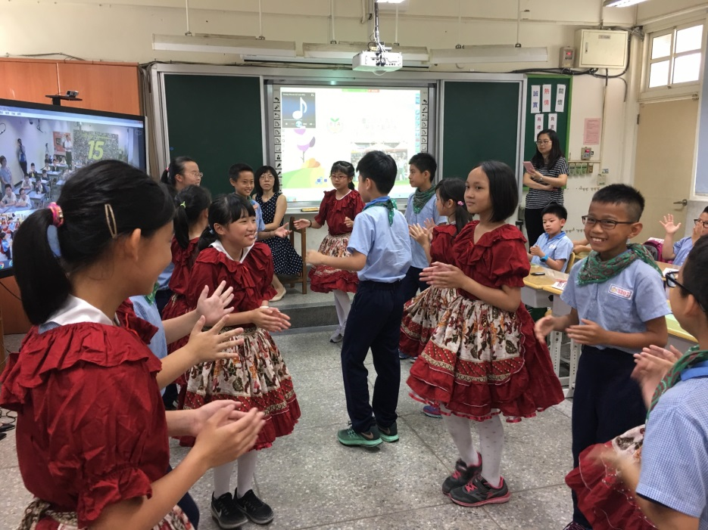
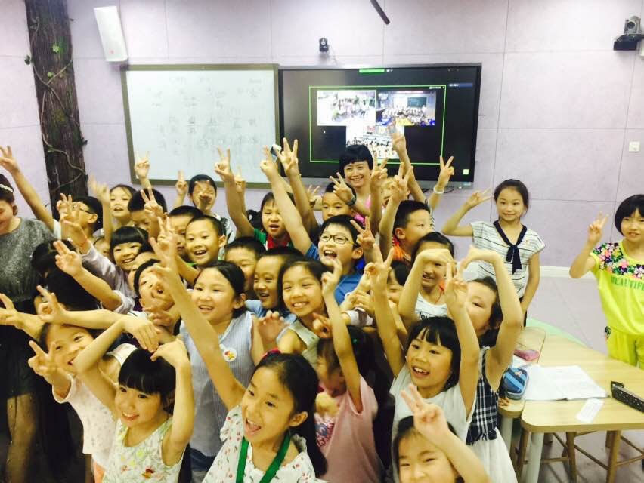

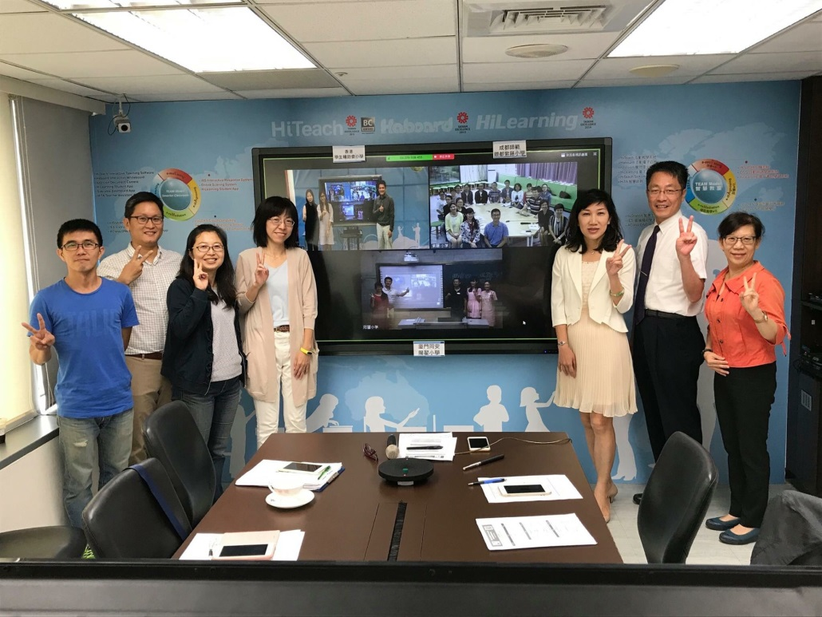

Slide 9
International
I-Common Advantages by Zhiqing
e-Common Appreciation
e-Common Preparation
e-Common Research
e-Common Learning
The Technology System of Big Data~
Common Education Technology System
The Smart Classroom with Data Interactions
Common Development of Teachers Cross School~
The cross-school smart common preparation and research
The innovative professional development of teachers
The Student-Centered Classroom~
Cooperative Learning, Interactions among Students
The real-time statistics contributes to teaching

Slide 10
