Slide 1
Wisdom classroom brings us to the ideal class form
Fujin Bilingual School Wang Yongqing
2017.11

Slide 2
01
General situation:
Low start high leap
02
Focus: Establish wisdom
educational environment
CONTENTS
03
Core: Tamp teachers'
professional literacy
04
Characteristic: Extract school
essential wisdom class pattern
05
Achievement: Wisdom
guide to growth

Slide 3
General situation: Low start high leap

Slide 4
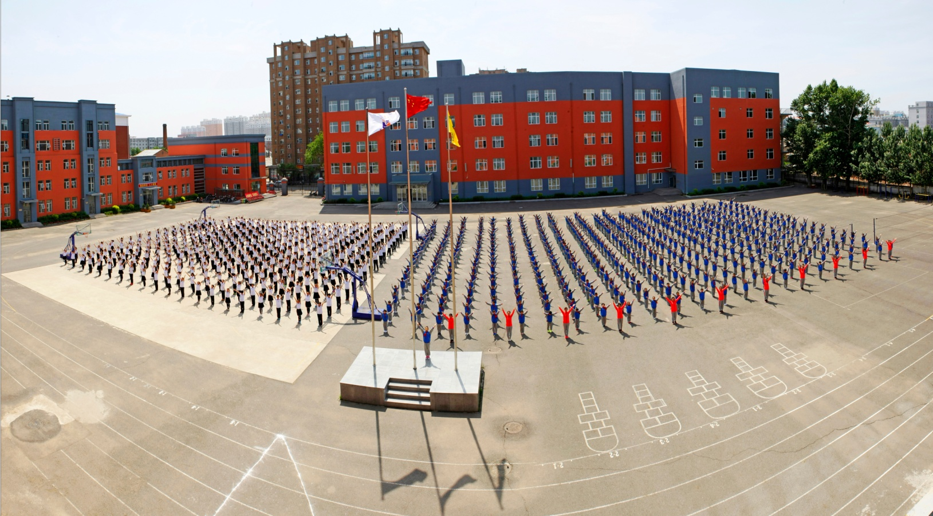
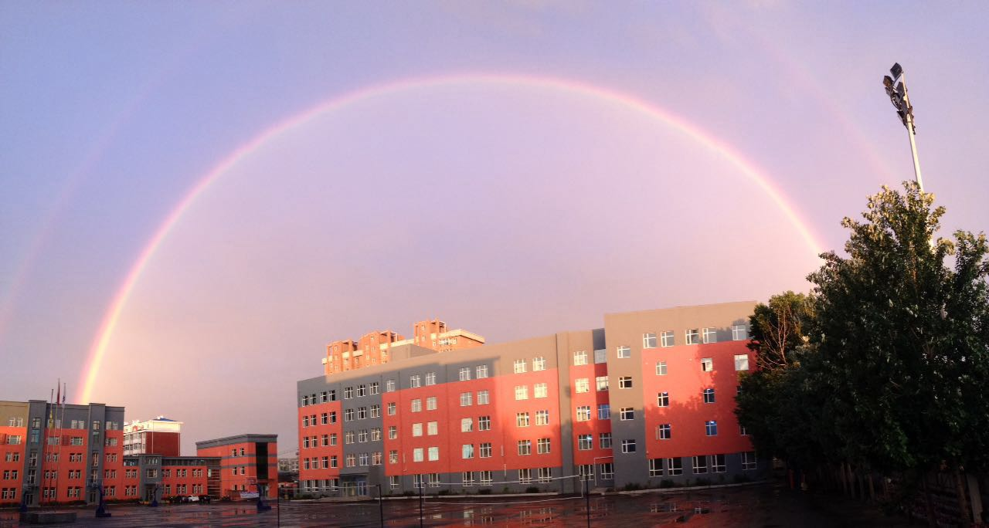
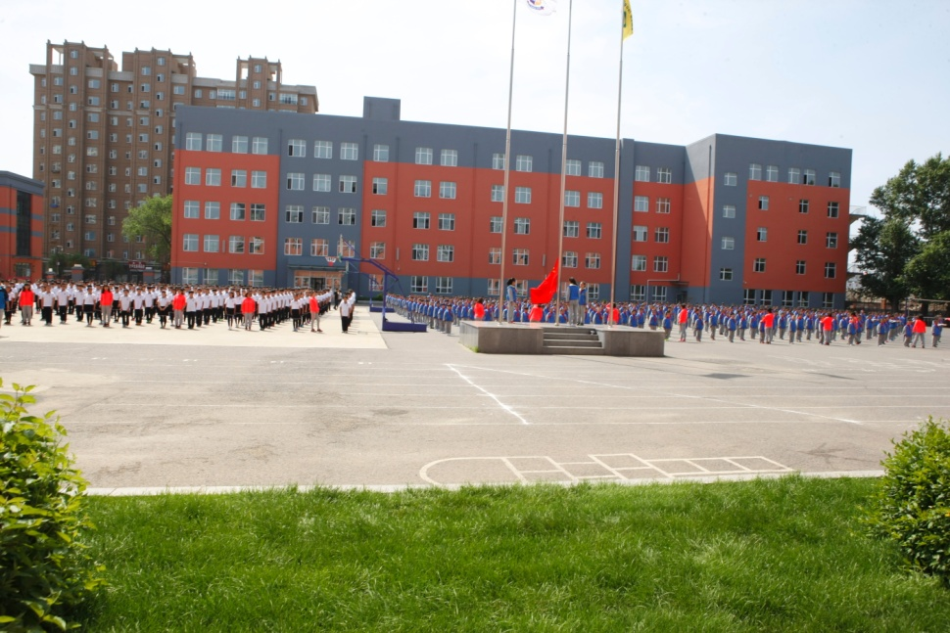
Basic information of school
School scale:
Middle school: 19 classes
Primary school: 29 classes
Student quantity:
Middle school: 878
Primary school:1305
Floor space of school：16900
Covered area of school：17500
The quantity of teaching and administrative staff: 175
The background of school：It locates at the reconstructive slum dwellers in the northeast part of Fujin. It’s a little bit remote, the literacy and income of students’ parents are not high.

Slide 5
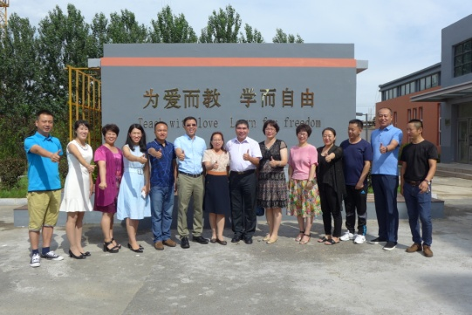
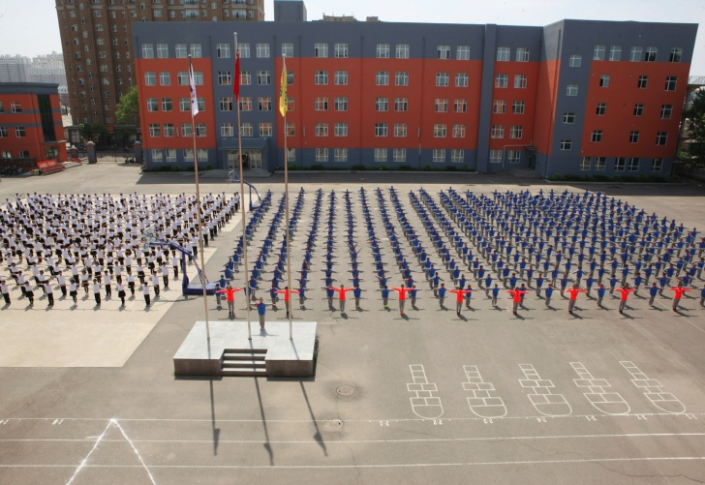
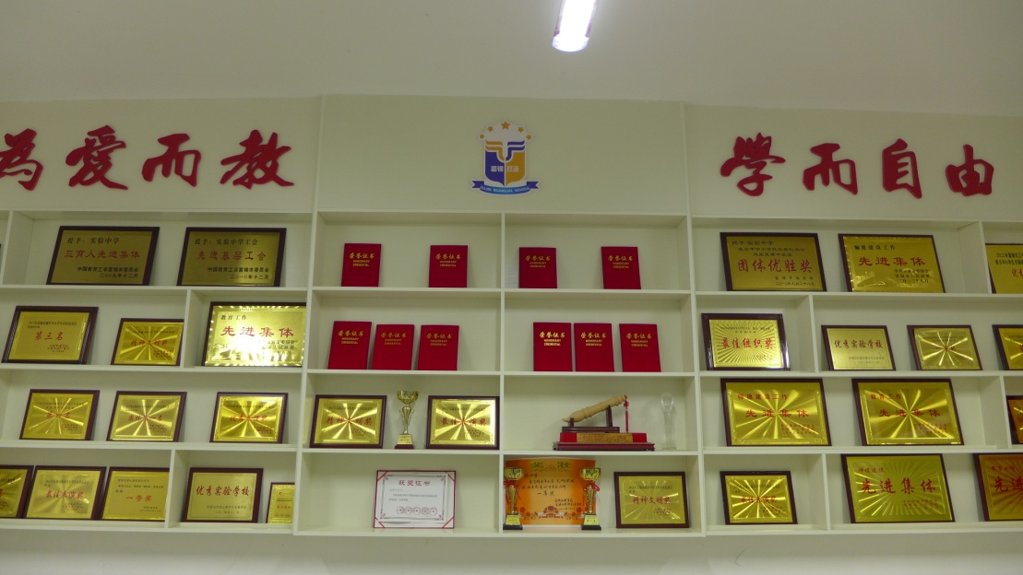
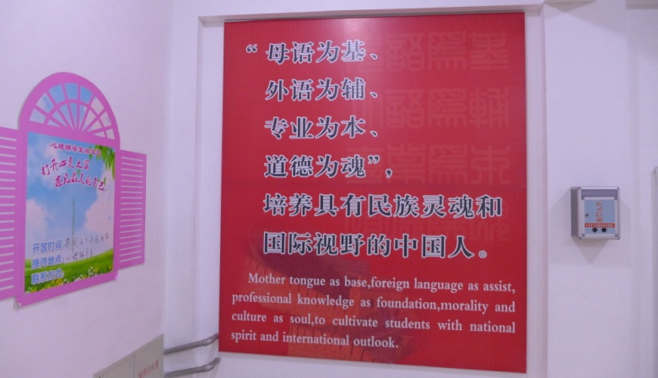
Basic information of school
philosophy of school
school motto
The goal of schooling
school characteristics

Slide 6
Focus: Establish wisdom educational environment

Slide 7
Establish wisdom classroom teaching pattern
There are 48TBL wisdom classrooms
Establish the specific guidance with the wisdom educational association
Establish regular tutoring and training plan with wisdom experts
establish interaction and communication system with other wisdom educational schools

Slide 8
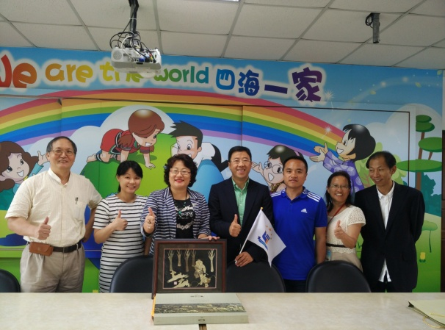
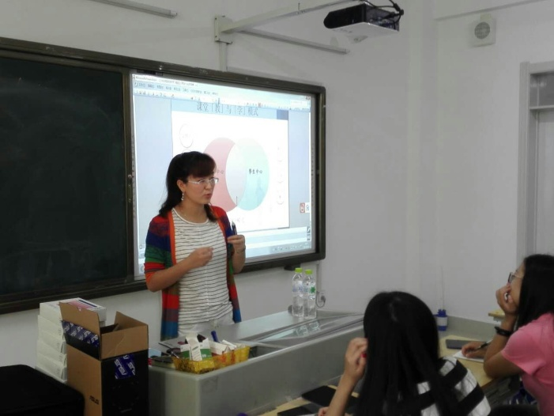
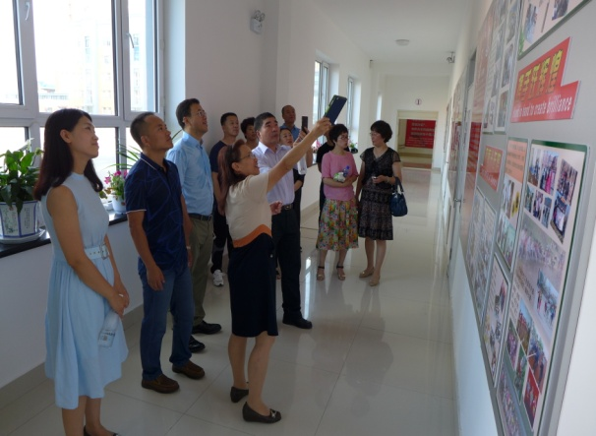
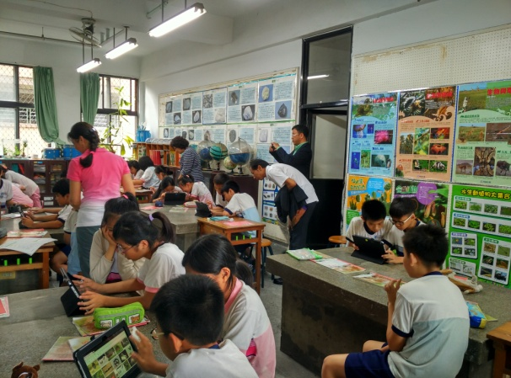
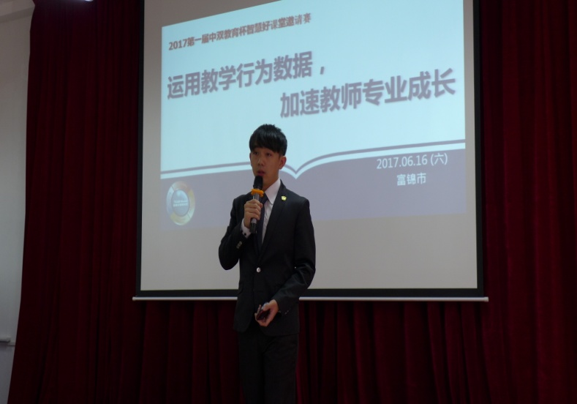
Establish wisdom classroom teaching pattern
observe Taiwan school
Guidance of the wisdom experts
Taiwan school pays a return visit to our school

Slide 9
Core: Tamp teachers' professional literacy

Slide 10
Develop the backbone teachers in order to make all the teachers get developed
Accelerate educating
by teaching
Experts’ leading and enlighting
output training plan of the backbone teachers
Developing with the help and supporting of the backbone teachers

Slide 11
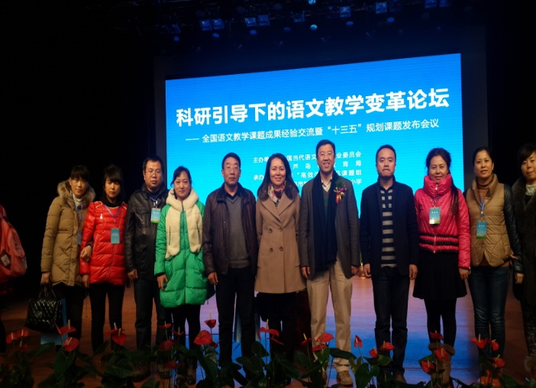
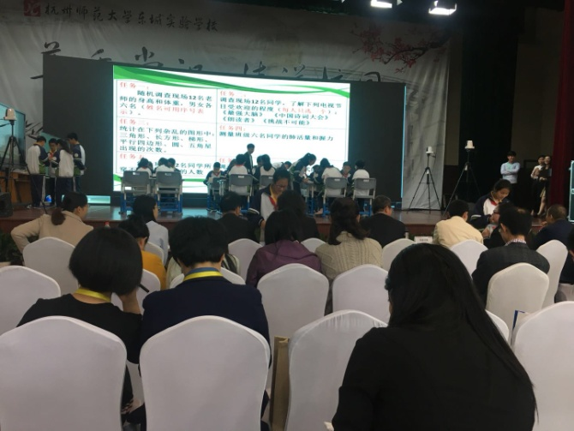
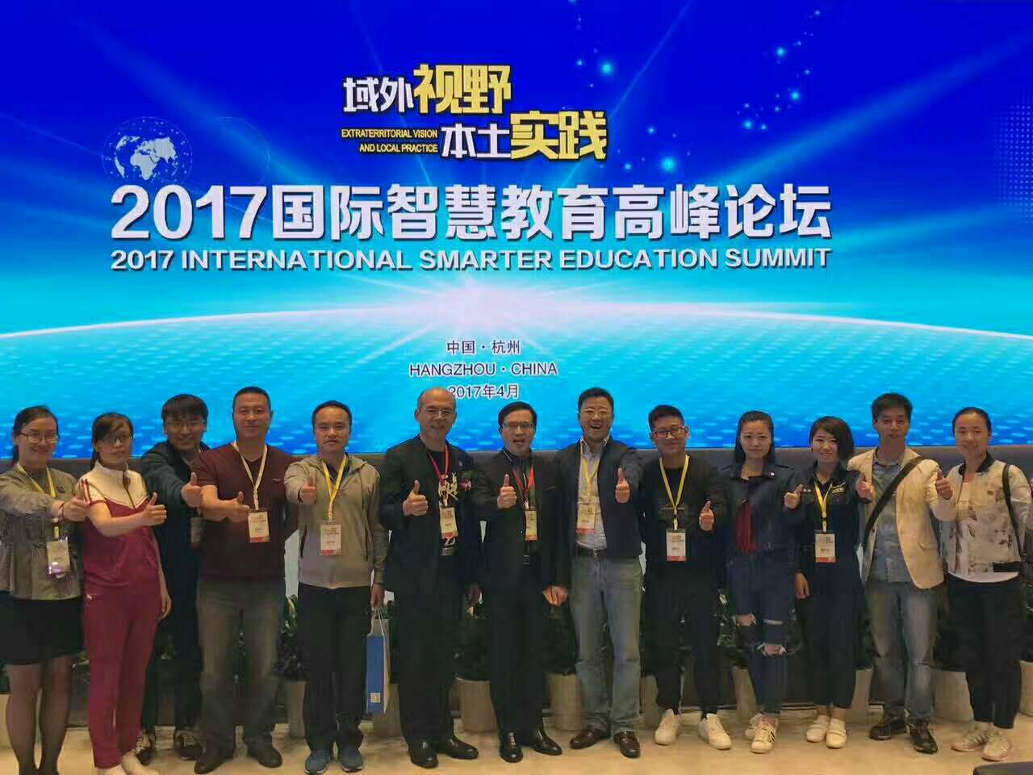
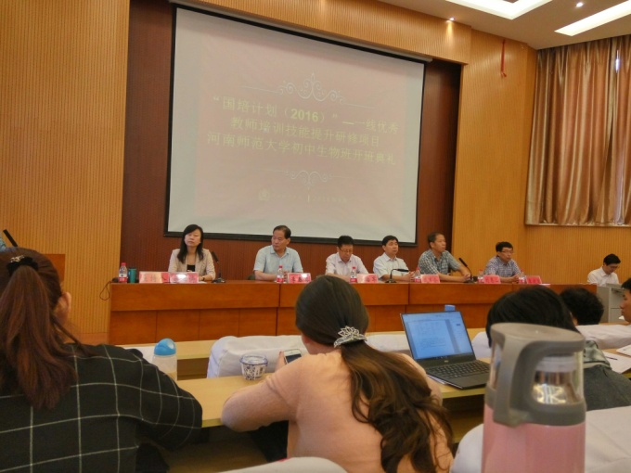
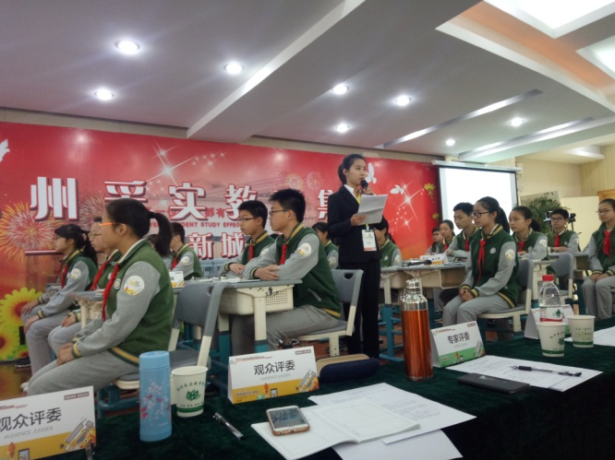
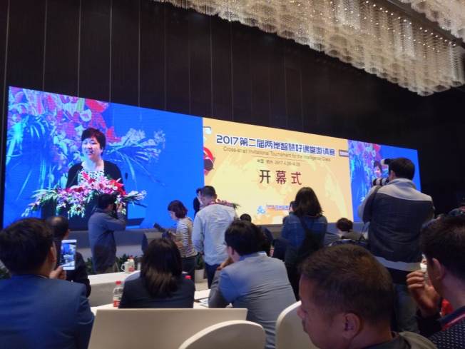
School sends backbone teachers out to study for many times and observing the live of wisdom education

Slide 12
Characteristic: Extract school
essential wisdom class pattern

Slide 13
Establish the wisdom education form which is full of fairness, happiness and effictiveness
01
Make the base as the carrier
make the subject as the direction
02
promotion by the scientific research team
03
synchronism of wisdom class and courses

Slide 14
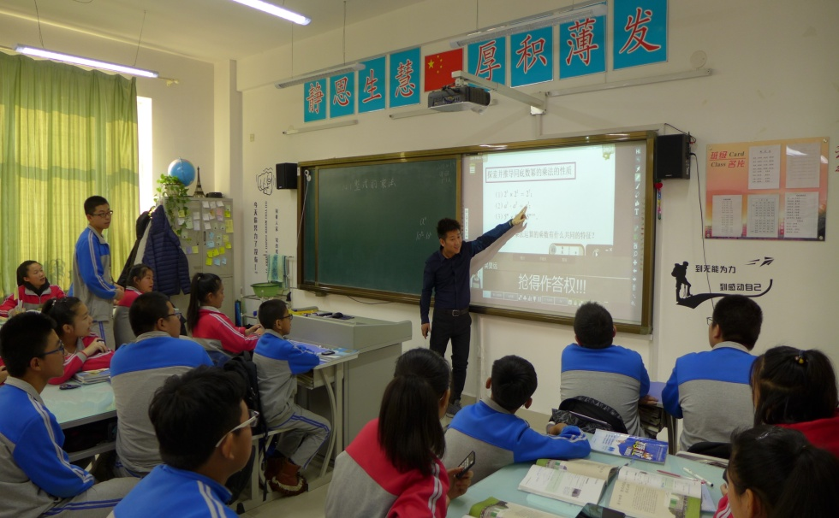
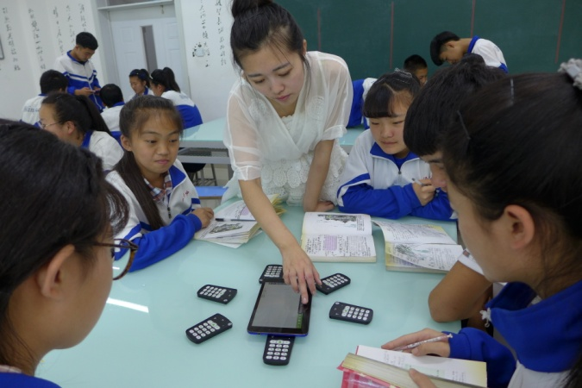
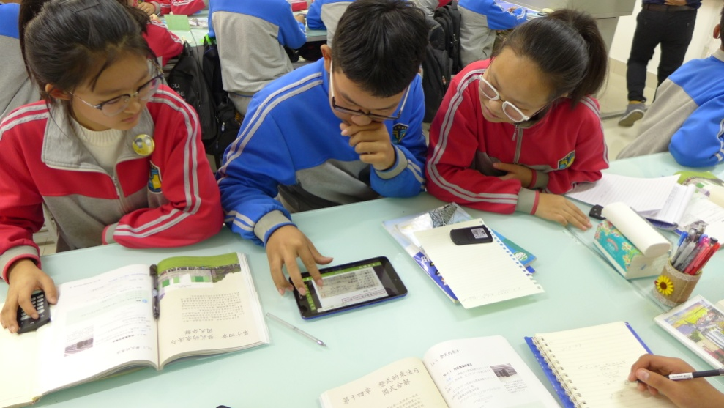
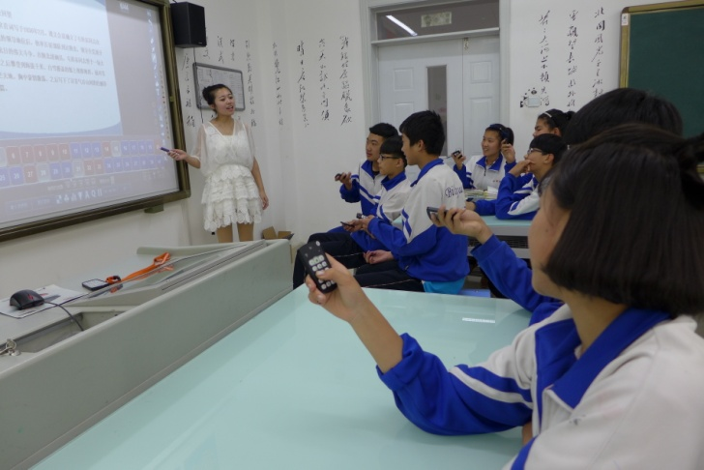
Import big data in the whole school，and build the wisdom education between school and family
「 AClassOne Wisdom learning partner 」 learning remedy
「AClassOne Wisdom learning partner」
「 reversal class 」 optimize class
「 Diagnostic report 」 grasp students’ general performance

Slide 15
Achievement: Wisdom guide to growth

Slide 16
Wisdom guide to development
Depend on the platform to improve
Developed by driving of the backbone teachers
The teaching quality improves quickly

Slide 17
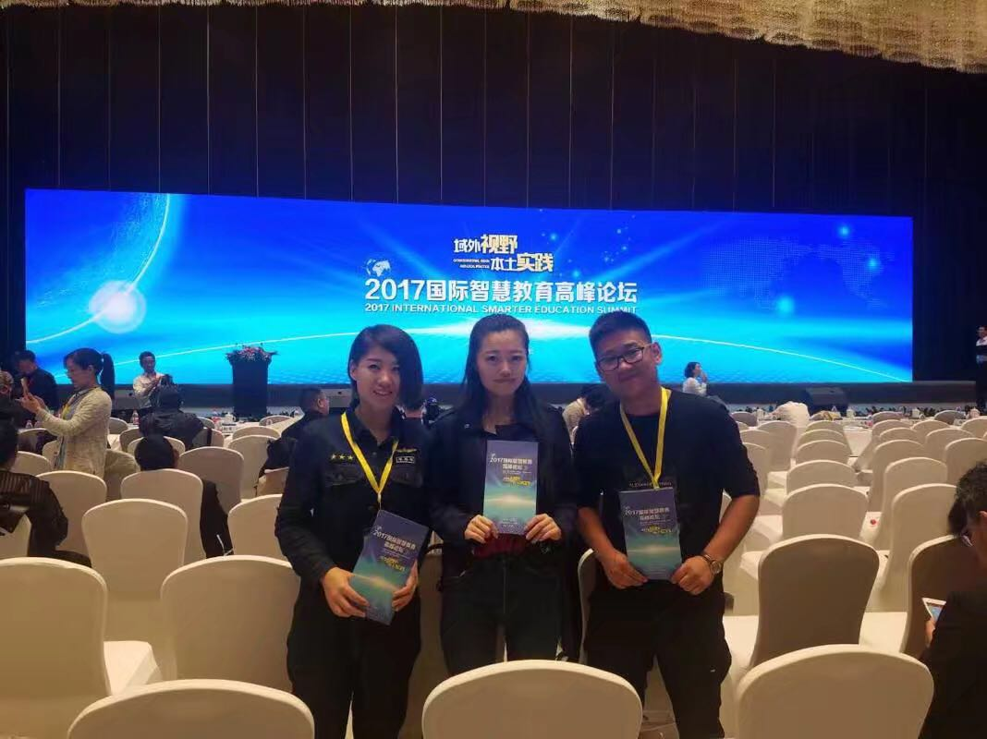
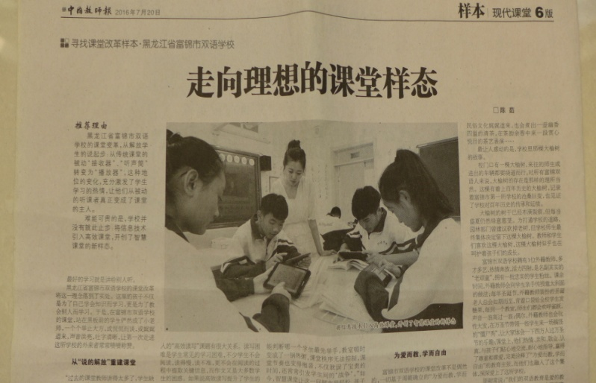
Wisdom class can be carried forward
Experts speak highly of Bilingual school
Teachers win awards
Chinese Teacher’s Daily

Slide 18
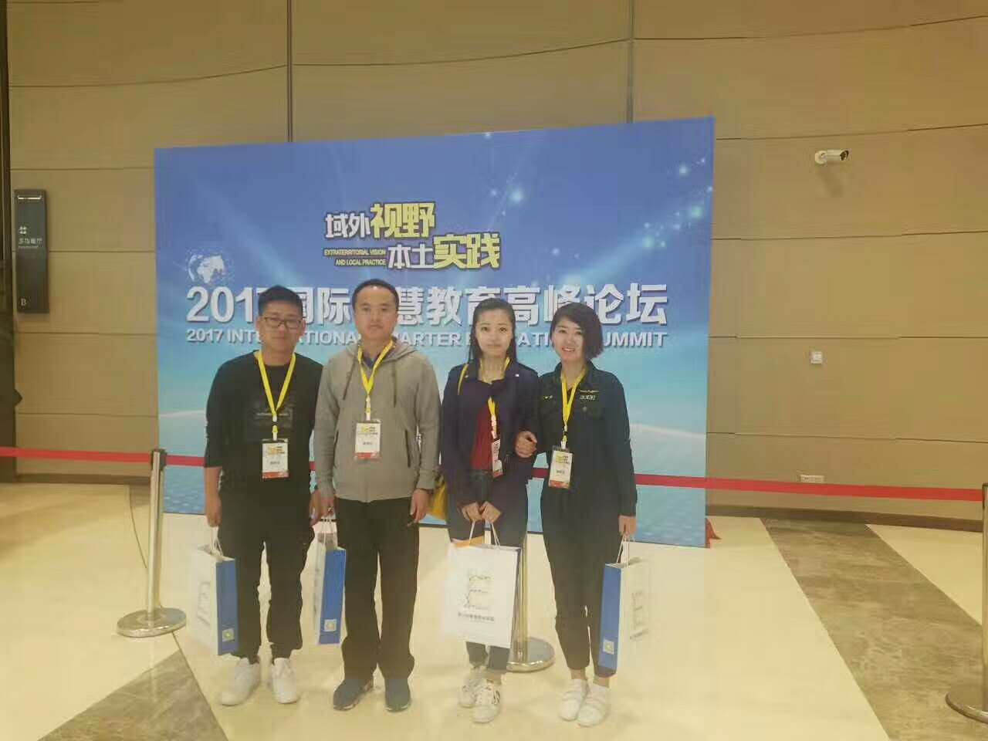
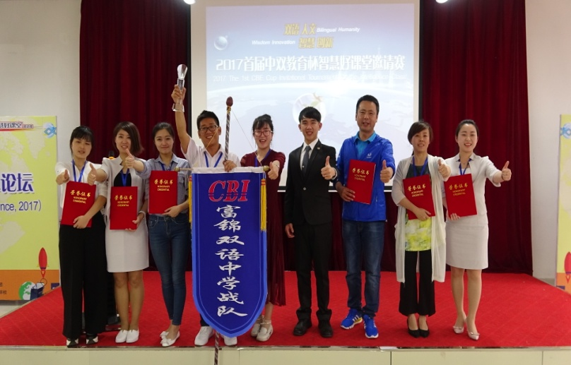
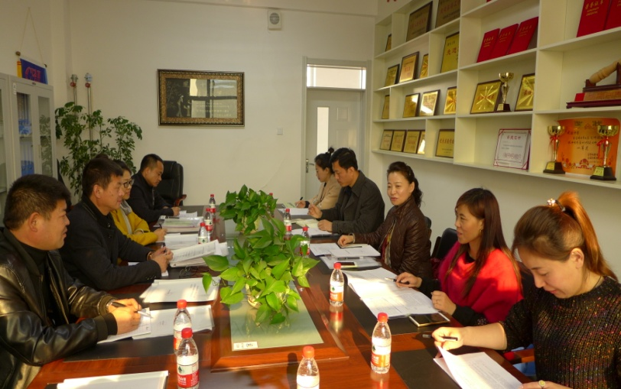
智慧课堂大有可为
The first prize of team total points
The establishment of wisdom class experimental base
Teachers win awards

Slide 19
Epilogue
The class is limited, while the development is limitless. Because of the wisdom class, humdrum class becomes more interesting. Wisdom teaching modle is updating and optimizing day by day. We have already set foot in the wisdom territory. We will gain the harvest more, we will be on the way of success forever.
Combust passion
Study hard
Create future
Fly ideality
United striving

Slide 20
Thanks for listening
Fujin Bilingual School Wang Yongqing

