Slide 1
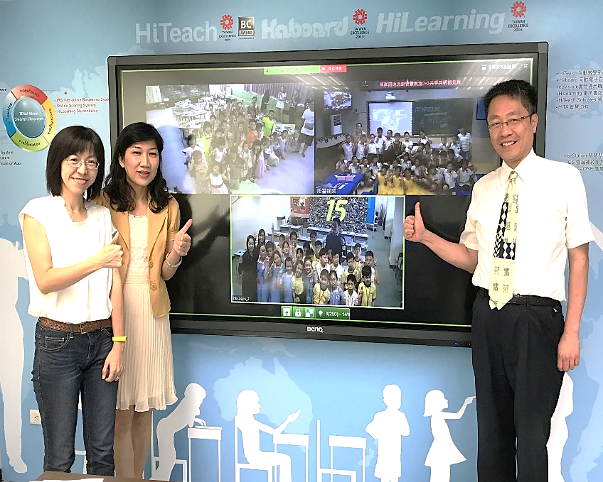
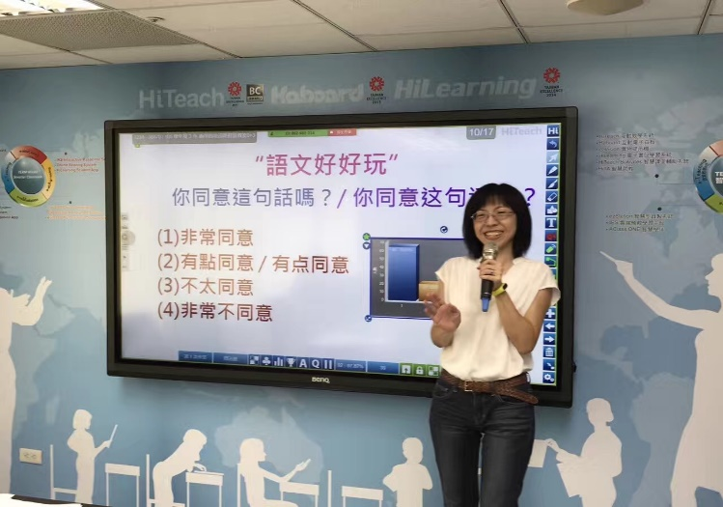
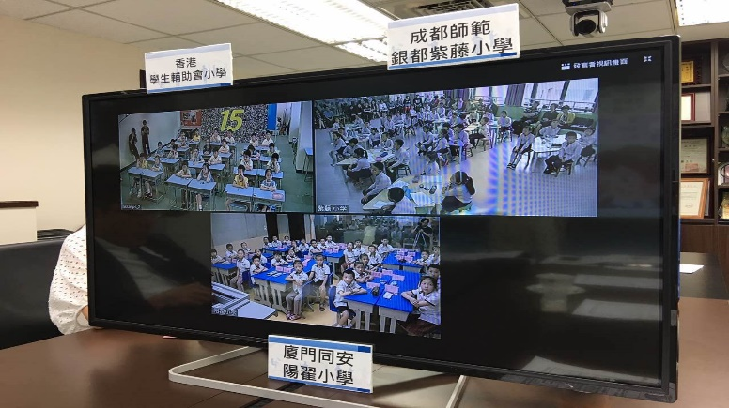
Four Locations Cross Strait TEAM Model Remote Smart Class Coalition
Group Intelligence
0+3
1+2
Smart Reading Education
Sharing, participating, and collaboration
Professional Development Model for Teachers

Slide 2
Analysis
Evaluation
Implementation
0+3, 1+2
Development
The main teacher evaluates his/her own teaching
Design
Teaching activities
Include the interactions among students from three places simultaneously
The assistant teacher presents the classroom observation
Collaboration and reflection
Revision of case study
Courseware preparation
Teaching plan
The assistant teacher leading students to participate
Address any emergency of learning
Expert review
Common teaching-review
The main teacher takes care of content analysis
The assistant teacher arrange the intervention
Instruction to pre-study
The assistant teacher suggests amendment
The assistant teacher provides the analysis of students
Main and assistant teacher Common preparation through video
Main and assistant teacher Common preparation through video

Slide 3
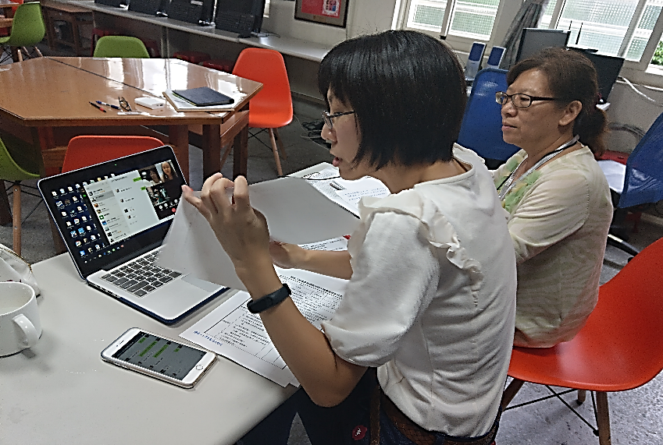
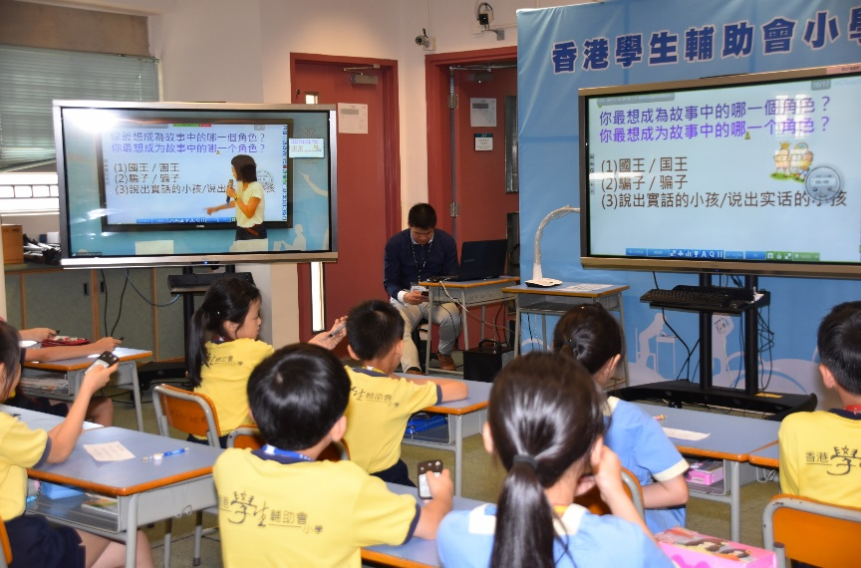
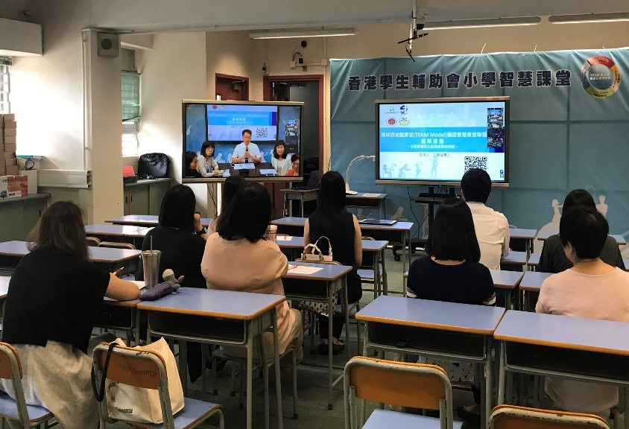
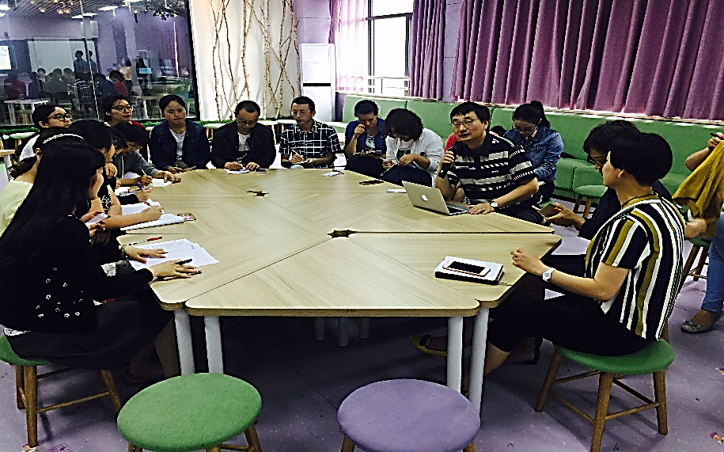
Interaction
Link
Sharing
Growth

Slide 4
Different requisites
Common preparation among teachers
Pre-test, pre-order
Class before a class
Time limit
Stability of transmission
Reduce the information being received
Tendency of oral expression
Provide visual clues
Adaptive
Active learning
Maximize the value of interaction

Slide 5
Learning occurs in the interactions
Distance is no longer remote Learning is abundant and diversified
~Vygotsky

