Slide 1
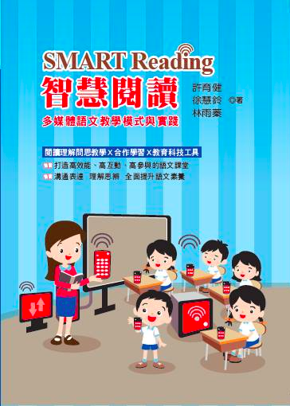
SMART Reading
National Taipei University of Education
Department of Language and Creative Writing
Associate Professor
HSU, YU CHIEN

Slide 2
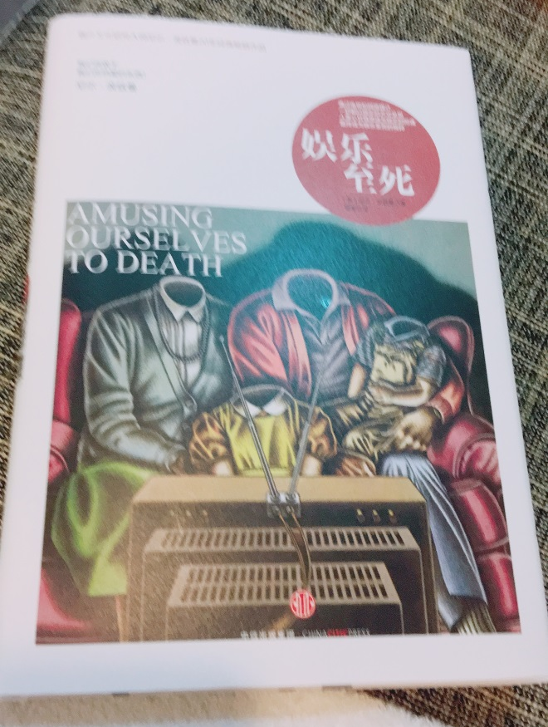

Slide 3
Reading, enhance your understanding to the world;
More importantly, reading offers you another angle to see this world.
～Marcel Proust

Slide 4
Reading is just like a journey
Reading comprehension is a mental process

Slide 5
PIRLS Reading Passage
Directly Extract
Directly Induce
Interpret and consolidate
Compare and evaluate

Slide 6
No thinking,
No learning.

Slide 7
Questioning
The professionalism of teachers- scaffolding for learning
Vygotsky: Zone of proximal development(ZPD)
Scaffolding

Slide 8
Questioning and Thinking for Reading
Preparation
1. Self-reading before class/ experience linking
Extract and induce information
Interpret and consolidate
Compare and evaluate
Development Activities
2. Questioning and Thinking for Reading
1. Text reading
2. ABC of questioning
4. Response and expression
3. TSG of Discussion
Personal thinking
Discussion in pairs
Group discussion
Answered by the whole class
Integrative activities
3. Learning review/ self evaluation

Slide 9
Smart Reading Education Model
Teaching procedure | Questioning/thinking teaching | Cooperative learning | Education Technologies
1. Preparation | 1-1 Reading before the class
 | 1-2 Questioning and thinking (linking)
2. Development Activities | 2-1 Three-time reading
 | 2-2 Questions of direct process
 | 2-3 Questions of indirect process
3. Integrative activities | 3-1 Review the learning
 | 3-2 Future Expectation

Slide 13
Ask
Think
Discuss
Say

Slide 14
1. Ask: the teacher asks
Q: if the last paragraph of the article is deleted,
how does this affect your reading?
**Tips from YC:
1. This is a question worthy to be discussed or requiring collective intelligence.
2. From the view of reading comprehension, usually it is an interpreting/integrating, or comparing/evaluating question

Slide 15
2. Thinking: personal thinking
Please write down your own answer in the notebook
You have one minute to think, and no discussing
Timing starts
**Tips from YC:
Personal thinking is a required condition for cooperative discussion and learning achievement.
Because no thinking, no learning. Have the students think on their own first!

Slide 16
3. Discussion: group discussion
No. 1 is the chair, No. 2 and 3 record the speech, and No. 4 start his/her speech. Sequence: 4->3->2->1
Here you have five minutes.
Four minutes for discussion (bell ringing once/ teacher announces)
One minute for speech preparation
Timing starts
**Tips from YC: listening is the base of discussion
Students shall be used to recap others’ comment in summary, and then express his/her own one.
Before ending the discussion, randomly choose the representative speaker of each group and have them prepare together.

Slide 17
4. Say: group sharing
Randomly pick up a group
Two-minute speech (stop when the bell rings)
The representative speaker is awarded with 30 points (in addition to the group score)
Teacher Evaluation Panel:
Good: 50 points/ Moderate: 30 points/ To be improved: 10 points
Teacher may give extra points for excellent performance
**Tips from YC: this is a dual-track awarding system for both individual and group (as the table below).
So whoever represents the group to speak will get points And also get high-score for the group
Easy question: choose randomly; difficult question: voluntary speech by group

Slide 18
Smart Reading Education Model
Teaching procedure | Questioning/thinking teaching | Cooperative learning | Smart Classroom
1. Preparation | 1-1 Reading before the class | Personal reading
 | 1-2 Questioning and thinking (linking) | Individual/ Pair/ Group
2. Development Activities | 2-1 Three-time reading | Individual/ Pair/ Group
 | 2-2 Questions of direct process | Individual/ Pair
 | 2-3 Questions of indirect process | Individual/ Pair/ Group
3. Integrative activities | 3-1 Review the learning | Individual/ Pair
 | 3-2 Future Expectation | Individual

Slide 20
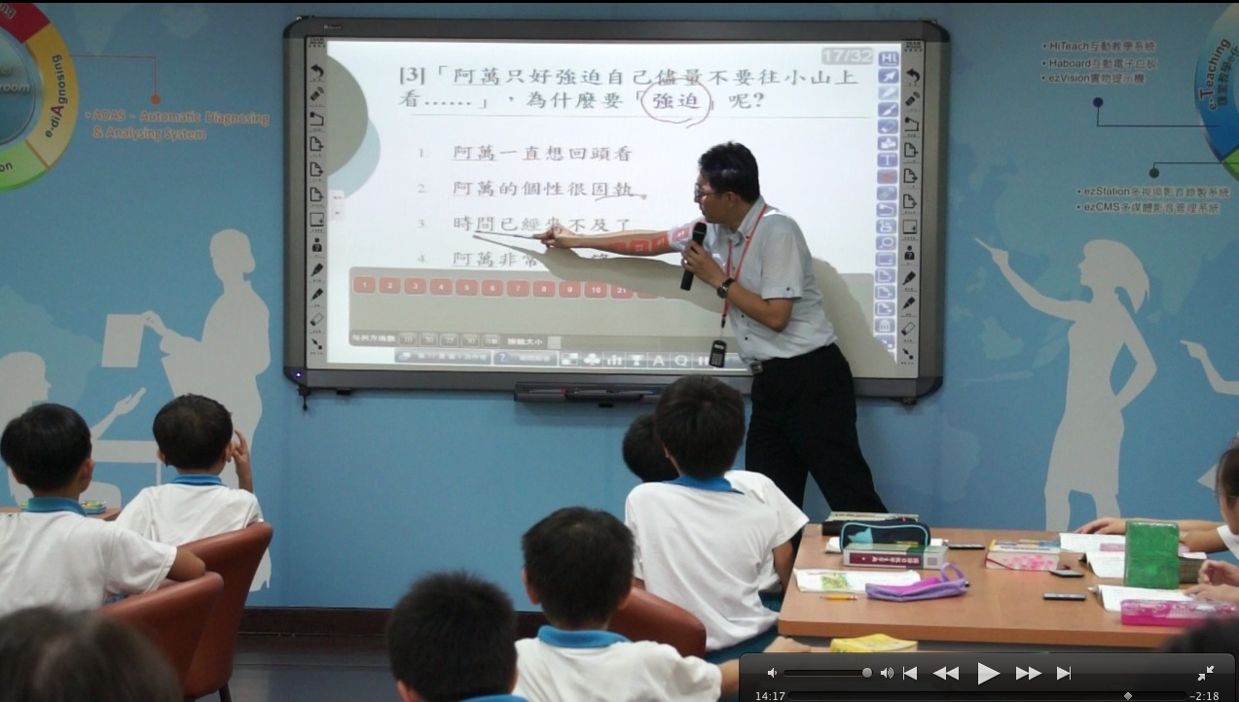
Smart Classroom Hi-Teach TBL
Electronics Writing Board/ Real-time Recording and Broadcasting
IRS real-time feedback system / IES
Tablet/ Phone HiTA

Slide 21
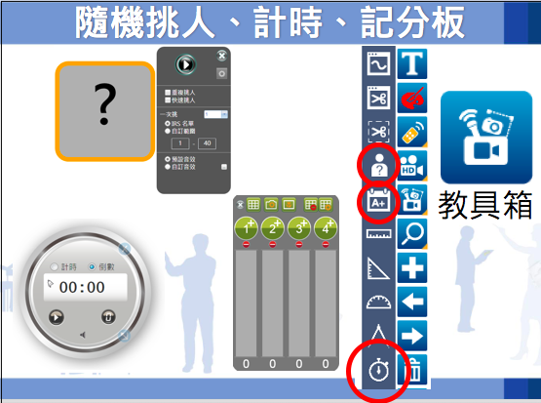

Slide 22
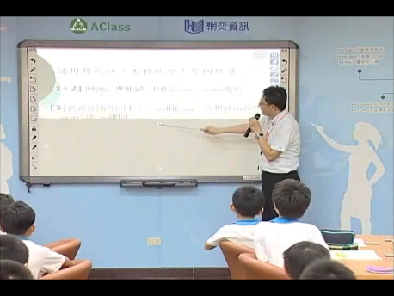
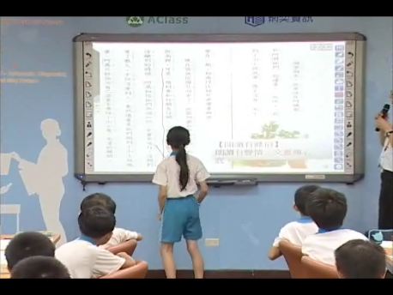
With an electronics writing board, the interactivity of teaching materials is stronger
Be it self-made digital teaching materials or digital teaching materials given with textbooks,
they will be easy to access and apply

Slide 23
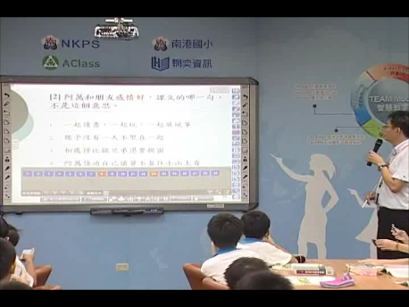
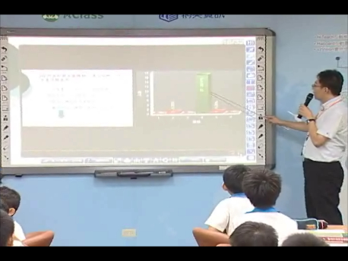
With IRS, the reading comprehensionof students is immediately observed
All students participates, and everything is recorded!

Slide 24
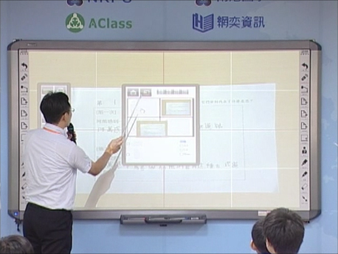
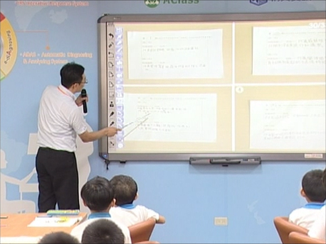
Tablet/ Phone HiTA
The outcome of students’ discussion is presented easily, and can be discussed, feed back, and modified immediately.

Slide 25
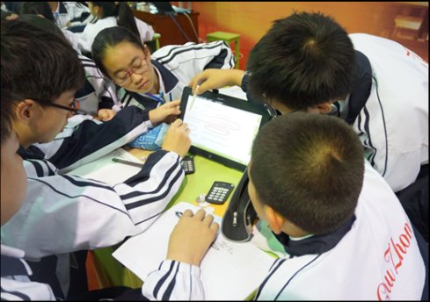
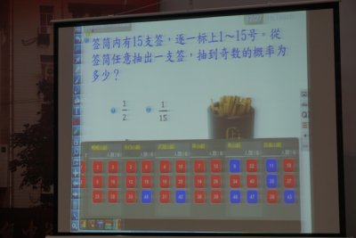
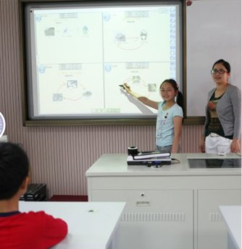
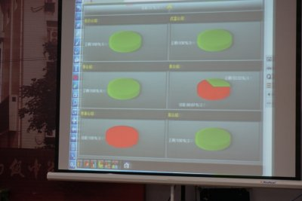

Slide 27
Smart Reading Education Model
Teaching program | Questioning/thinking teaching | Cooperative learning | Smart Classroom
1. Preparation | 1-1 Reading before the class | Personal reading | Online Course
 | 1-2 Questioning and thinking (linking) | Individual/ Pair/ Group | Responding one’s thought
2. Development Activities | 2-1 Three-time reading | Individual/ Pair/ Group | Smart School Bags
 | 2-2 Questions of direct process | Individual/ Pair | Real-Time feedback IRS
 | 2-3 Questions of indirect process | Individual/ Pair/ Group | Smart School Bags Episcope
3. Integrative activities | 3-1 Review the learning | Individual/ Pair | Smart School Bags
 | 3-2 Future Expectation | Individual | Online Reflection

Slide 28
[Practising/Experimenting School]
Nangang Elementary School, Taipei City; Municipal ZhiQin Elementary School, Taipei City; Jinhua Elementary School, Taipei City; Beixin Elementary School, New Taipei City; Zhongxiao Elementary School, New Taipei City; Laomei Elementary School, New Taipei City; Luman Elementary School, Chiayi County; Taoyuan Elementary School, Taoyuan City; Da You Junior High School, Taoyuan City; Lontan Junior High School, Taoyuan City; Huejen School, Jianbei District, Jianbei Central Elementary School, Jianbei Experimental Elementary School, Ningbo City, Zhejiang Province; Yingdu Elementary School, Chengshi Eldo Experimental Primary School, Kaoxin District, Chengdu City, Szechuang Province; Huayang Experimental Elementary School, Tienfu New District, Chengdu City, Szechuang Province; Fenseting Elementary School, Dongchen District, Beijing City; Wangjing Experimental School, Zhaoyang Distric, Beijing City

